Slide 1
Perioperative Nutrition
Becky Massey, MD
Division of Head and Neck Oncology

Slide 2
Disclosures
None

Slide 3
Goals
Understand trends in nutrition for health/cancer prevention
Consider Preoperative interventions
Be aware of available perioperative protocols
Recognize post-treatment/survivorship

Slide 4
What is an ideal diet/nutrition?
Free radical interact with DNA causing cell damage and cancer
Antioxidants inhibit oxidation;
Antioxidants (ie vitamin c) in supplement or diet form no evidence of cancer reduction
General anti-inflammatory benefit
Tumeric, sugar

Slide 5
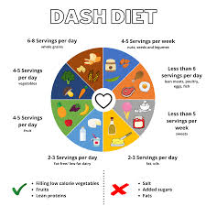



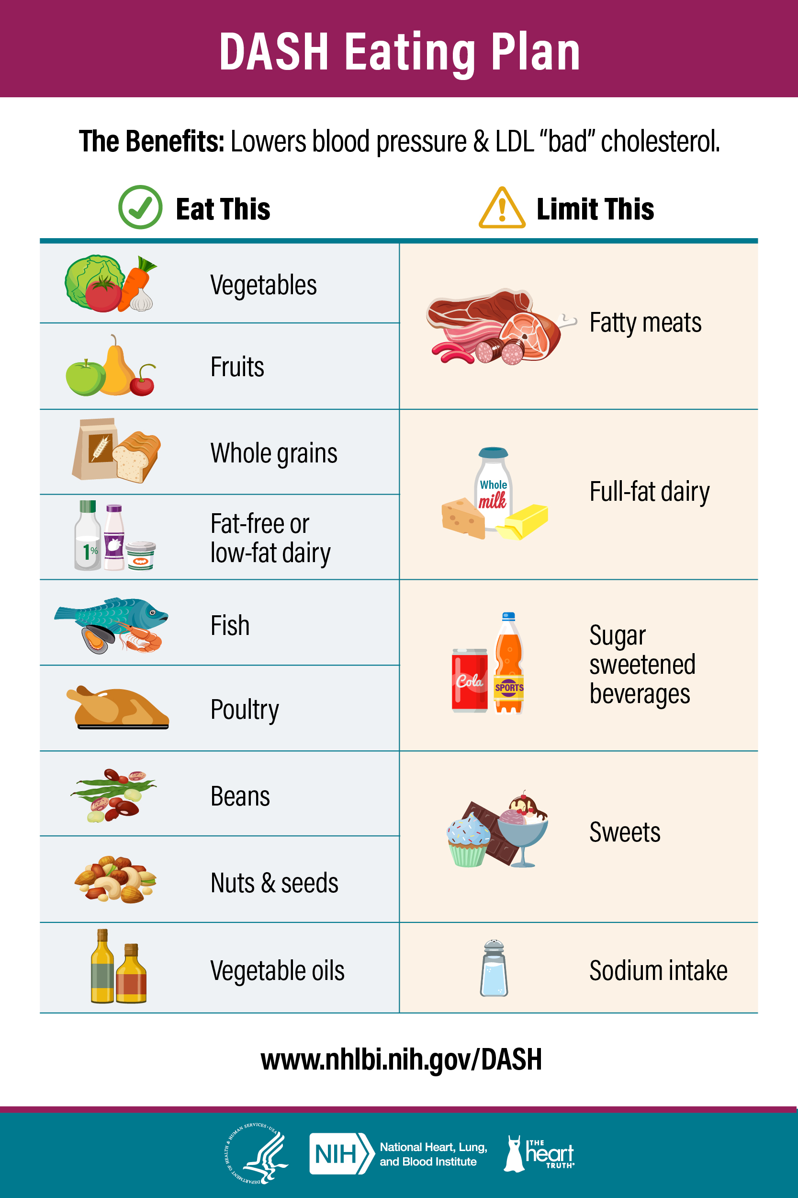


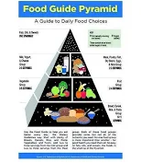
2024 Diet Trends
Notes:
Essential determinants of chronic disease, hearing loss, LPR; no perfect diet: plant predominant, healthy whole foods, limited processed foods

Slide 6
Who is at risk for malnutrition?
Undernutrition most common in older adults and cancer patient
  Less intake due to anxiety, depression, pain, dysphagia
  Less energy than needed (especially protein, fat vitamins and break down fat and muscle)
  Protein energy malnutrition impairs immune system
  Can still be overweight and have malnutrition

Slide 7
Preoperative Screening
American Society of Parenteral and Enteral Nutrition (ASPEN)
Adults should be considered at risk if they have any of the following:
Involuntary loss of 10% or more of usual body weight within 6 months, or involuntary loss of greater than or 5% or more of usual body weight in 1 month.
Involuntary loss or gain of 10 pounds within 6 months.
Body mass index less than 18.5 kg/m2 or greater than 25 kg/m2.
Chronic disease.
Increased metabolic requirements.
Altered diets or diet schedules.
Inadequate nutrition intake, including not receiving food or nutrition products for greater than 7 days.
White JV, Guenter P, et al. Consensus Statement: Academy of Nutrition and Dietetics and American Society for Parenteral and Enteral Nutrition: Characteristics Recommended for the Identification and Documentation of Adult Malnutrition (Under-nutrition). JPEN J Parent Ent Nutr. 2012; 36:275-283.

Slide 8

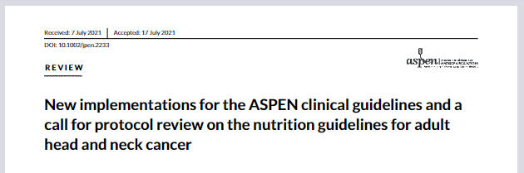
Head and Neck Protocols
Protocol development questions:
  Screen vs not screen
  Length and frequency of dietetic support
  Prophylactic vs Reactive Feeding tube
  Standard vs enhanced enteral nutrition

Slide 9
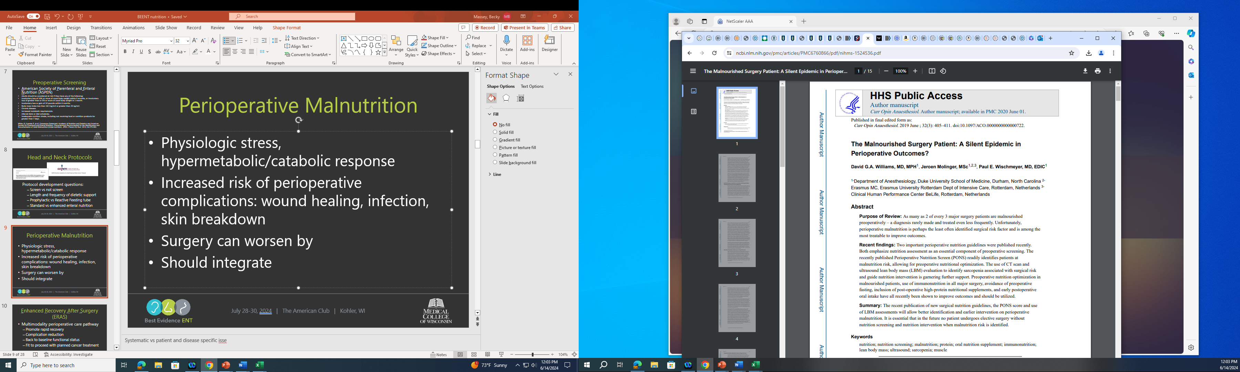
Perioperative Malnutrition
Physiologic stress, hypermetabolic/catabolic response
Increased risk of perioperative complications: wound healing, infection, skin breakdown
Surgery can worsen
Curr Opin Anaesthesiol. 2019 June ; 32(3): 405–411. doi:10.1097/ACO.0000000000000722.
Notes:
Systematic vs patient and disease specific isse

Slide 10
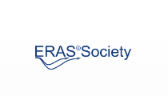
Enhanced Recovery After Surgery
(ERAS)
Multimodality perioperative care pathway
  Promote rapid recovery
  Complication reduction
  Back to baseline functional status
  Fit to proceed with planned cancer treatment
Enhanced Recovery After Surgery Society for Perioperative Care (www.erasociety.org).
Notes:
Guidline for all involved in care,multidisclipinary

Slide 11
ERAS
Early postoperative feeding
Early mobilization to reduce muscle loss
Initially colorectal population in 2002
Expanded to many subspecialities
Notes:
Pioneered in Denmark as treatment algorithm to optimize postop care after colorectal surgery; reported 2002; wide expansion with reported improvements in complication rate and length of stay; goal=get back to baseline function asap. For use, goal to finish intended treatment

Slide 12
ERAS
Initiative for “fast-track”, “clinical pathway”
  Complication reduction
  Cost
  LOS
  Readmissions
  Patient experience

Slide 13

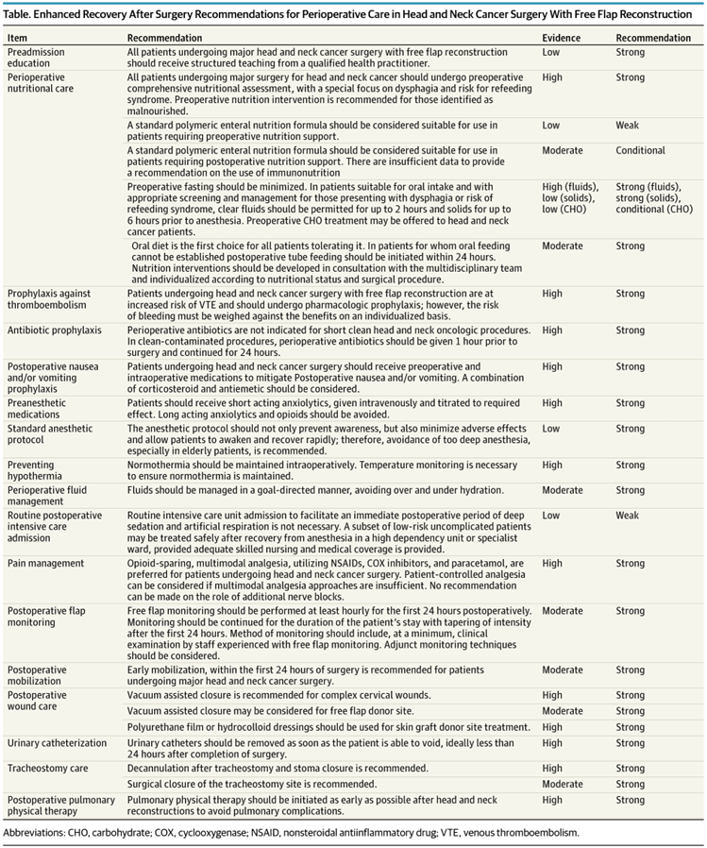
JAMA Otolaryngol Head Neck Surg. 2017;143(3):292-303. doi:10.1001/jamaoto.2016.2981
Principles
  Preoperative patient education
  Perioperative nutritional care
  VTE prophylaxis
  Antibiotic prophylaxis
  Perioperative IV fluid management
  Avoidance of tracheostomy when possible
  Pain management
  Avoidance of ICU/sedation

Slide 14
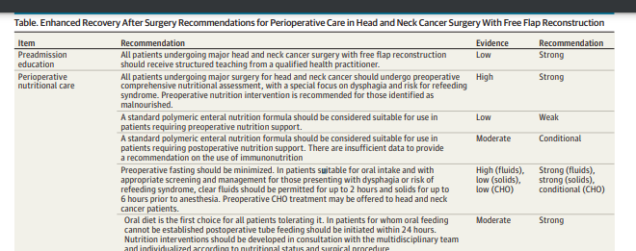
ERAS HN Guidelines
Early feeding:

Slide 15
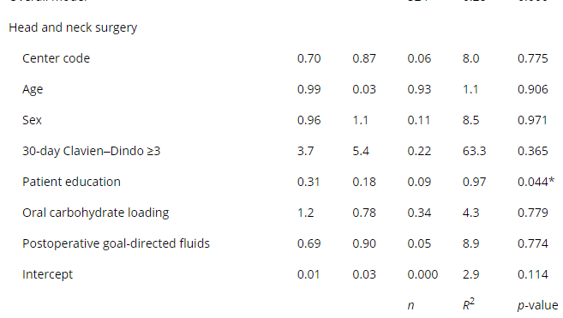
ERAS Head and Neck
  Enhanced Recovery after Surgery recommendations that most impact patient care: A multi-institutional, multidiscipline analysis in the United States
  Only area of surgery that preoperative compliance items predicted reductions in adverse outcomes was the pancreas, where oral carbohydrate loading reduced LOS and head and neck procedures, where the odds of mortality decreased with preoperative education
  Effect of itemized compliance recommendations and mortality by surgery type
Cochran, A.R., Shaw, G., Jr, Shue-McGuffin, K., Elias, K. and Vrochides, D. (2024), Enhanced Recovery after Surgery recommendations that most impact patient care: A multi-institutional, multidiscipline analysis in the United States. World J Surg, 48: 791-800. https://doi.org/10.1002/wjs.12124

Slide 16
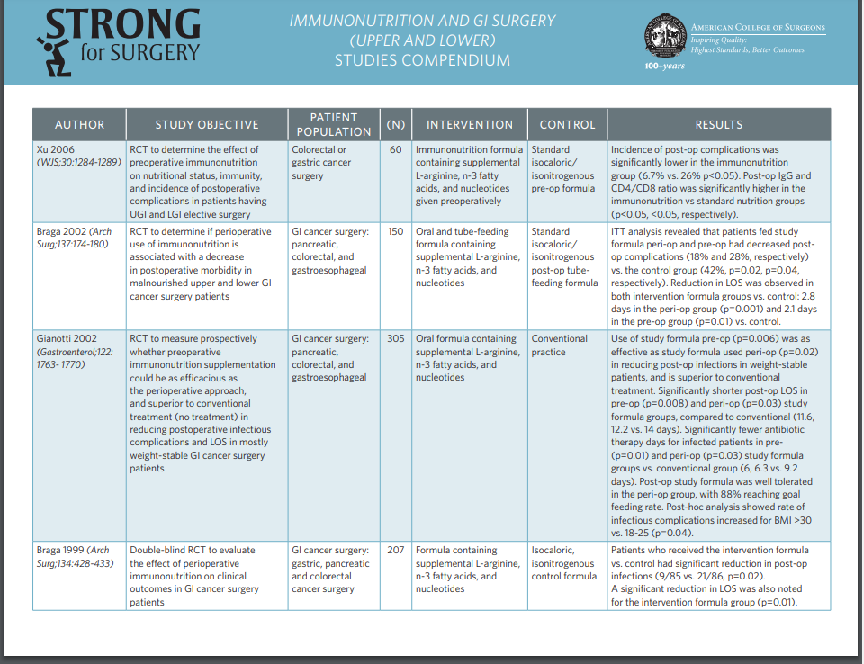
ACS Initiatives
The Strong for Surgery program recommends testing albumin levels of patients prior to surgery to help determine risk for postsurgical complications. Surgical Care and Outcomes Assessment Program (SCOAP) 2005–2011 data indicates that there is a 200% to 300% increase in rates of re-operation and/or death in patients with an albumin of <3 g/dl

Slide 17
Support/Intervention
Oral preferential to enteral to parenteral
Shouldn’t delay surgery unnecessarily
Old thoughts:
Despite low serum albumin being associated with poorer surgical outcomes, doesn’t necessarily reflect nutritional state.
Can be reflective of chronic inflammation, protein losing enteropathy, proteinuria, or hepatic dysfunction, but does not reflect malnutrition
Severe anorexia nervosa have a normal serum albumin

Slide 18
Dogmatic Practices
NPO after MN
Complete NPO
Bedrest

Slide 19
NPO after Midnight
Fasting from midnight prior to surgery originates from historical, institutional, and clinician-driven practices. Despite evidence of poorer outcomes and delayed recovery with prolonged fasting, outdated surgical fasting practices persist.
Clear liquids beneficial up to 2 hours prior to anesthesia
Carbohydrate loading: excessive starvation times cause dehydration, induce stress response resulting in catabolic state (increases insulin resistance and periop hyperglycemia); Carbohydrate loading drinks 2 hours prior to surgery.

Slide 20
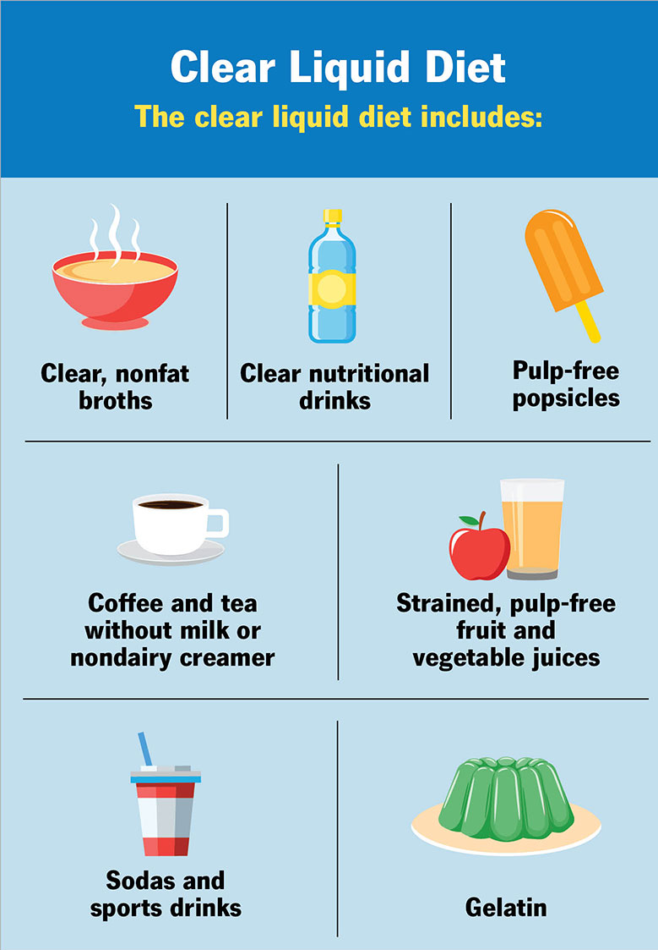
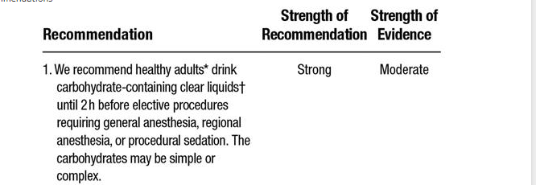
New ASA Guidelines
Practice Guidelines for Preoperative Fasting: Carbohydrate-containing Clear Liquids with or without Protein, Chewing Gum, and Pediatric Fasting Duration—A Modular Update of the 2017 American Society of Anesthesiologists Practice Guidelines for Preoperative Fasting
Anesthesiology February 2023, Vol. 138, 132–151.
Notes:
Policy in effect 5/1 at FH’ Healthy and elective

Slide 21
Immunonutrition
Modified nutritional supplements to add arginine, fatty acids, glutamine to upregulate host immune response
Goals:
  Modulate inflammatory response
  Improve protein synthesis after surgery
Mixed results in HN population; role in enhanced recovery pathway unclear
Immunopeptide feeds with no clear benefit to HN in systemic reviews
ERAS-HN does NOT recommend
Neck Cancer Surgery With Free Flap Reconstruction: A

Slide 22
Nutrition: what is best for patients?
Dietitian should be part of MDT for HN cancer
Nutrition support for 1-2 weeks preop
Consider CHO loading if safe
Initiate tube feeds within 24H surgery

Slide 23
Cancer Cachexia Syndrome
Decreased appetite
Weight loss
Metabolic alterations resistant to nutrition
Pro-inflammatory state

Slide 24
What can you do?
Recognize nutrition risk
Start preoperative supplement/EN
Reduce NPO time
Feed within 24h surgery
Monitor long-term
Know resources for survivorship

Slide 25



Survivorship tools
Give basic advice on good nutrition after cancer
Engage Dietican

