Slide 1
Posture/Core Strength/Breathing/Sleep
B Tucker Woodson MD
Professor and Chief Division of Sleep Medicine and Sleep Surgery
Department of Otolaryngology
Medical College Wisconsin
Milwaukee WI, USA

Slide 2
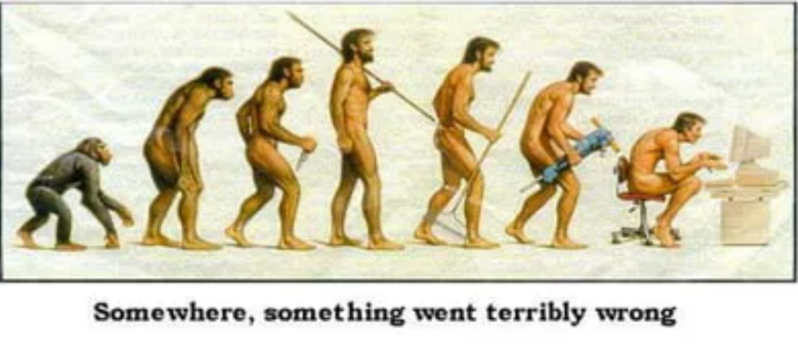
Posture and Wellness
Posture neck, back and shoulder pain and injury, stiffness, stress incontinence, heartburn/slowed digestion due to increased pressure on the abdomen
Major risk factor for respiration and OSA

Slide 3


Slide 4
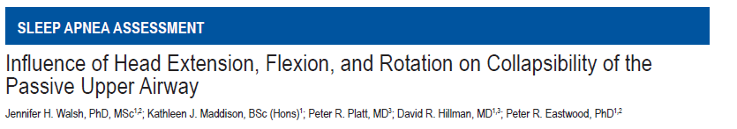
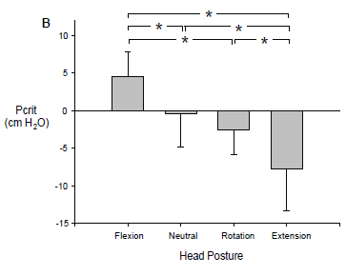
Pcrit 3.7 ± 2.9 to –9.4 ± 3.8 cm H2O (P < 0.01) when the head was flexed and extended
Subgroup Pcrit reduced to level associated with no OSA

Slide 5
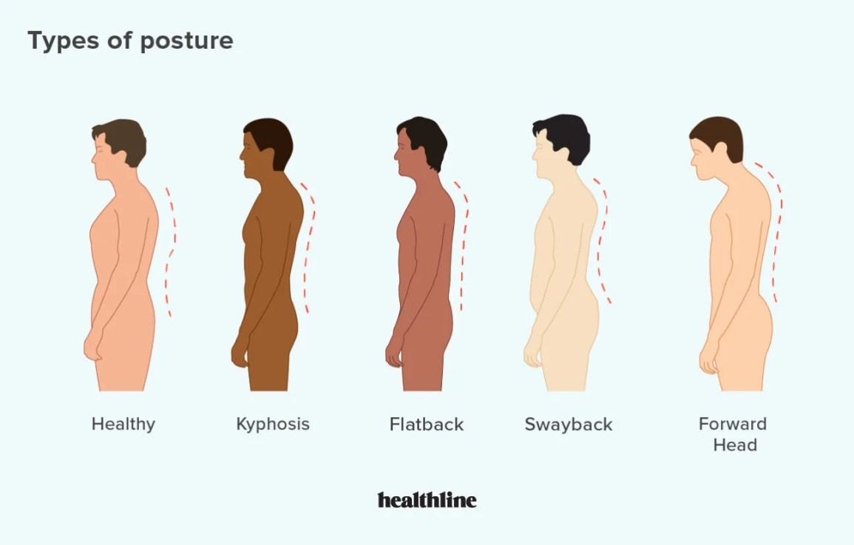
Types of Posture
Static
Dynamic

Slide 6
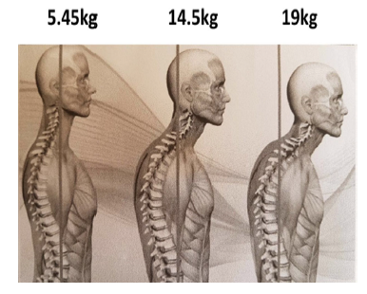
Posture and Breathing
Two issues
  Aging
  Airway compensation

Slide 7
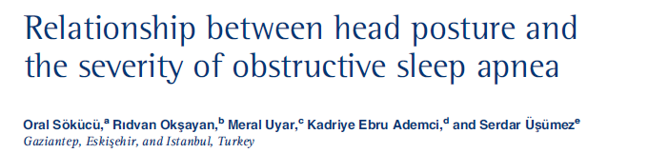
All OSA significantly different than control
Angulation correlated to OSA severity

Slide 8
Posture Effect on Airway
Pulmonary
  Impairs ventilation due to lung volume loss, diaphragm and intercostal dysfuction and rib cage rigidity
Pharynx
  Posterior narrowing, loss of lateral wall strain due to shortening of muscles, downward position hyoid
Posterior choanae (ie nose)
  AP narrowing nasopharynx

Slide 9
Poor Posture: Causes
Repetitive motions/poor biomechanics/Injuries
Weak muscles
Genes
Poor ergonomics : Phone / tablet / computer (forward positioning ie ventral shortening with weak extensors)
One shoulder heavy bags/purses
Obesity

Slide 10
Normal vs Abnormal Aging
Hyperkyphosis = thoracic spine curvature > 45º
Intervertebral disc degeneration, compression fractures, weakness spinal extensor muscles, reduced mobility, anterior longitudinal ligament calcification, shortened pectoral muscles visual, vestibular, and somatosensory loss impacting posture

Slide 11
Treatment of Posture
Exercise
  strengthen longer muscles
  spinal extensor strengthening
  Core stability
Flexibility
  stretch shortened muscles,
  increase mobility,
  spinal flexibility
Diet
  Calcium, vitamin D, omega 3 fatty acid
Other Bed Pillow Mattresses …..

Slide 12
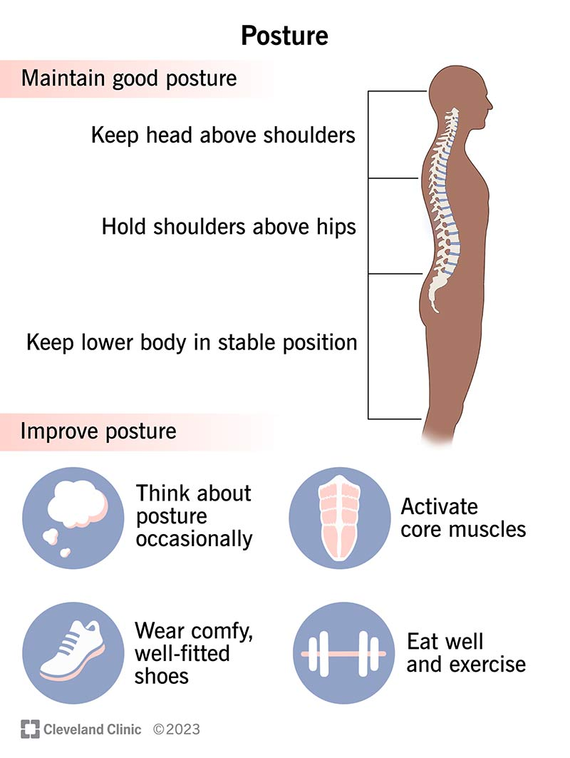
Step 1
Think about it

Slide 13
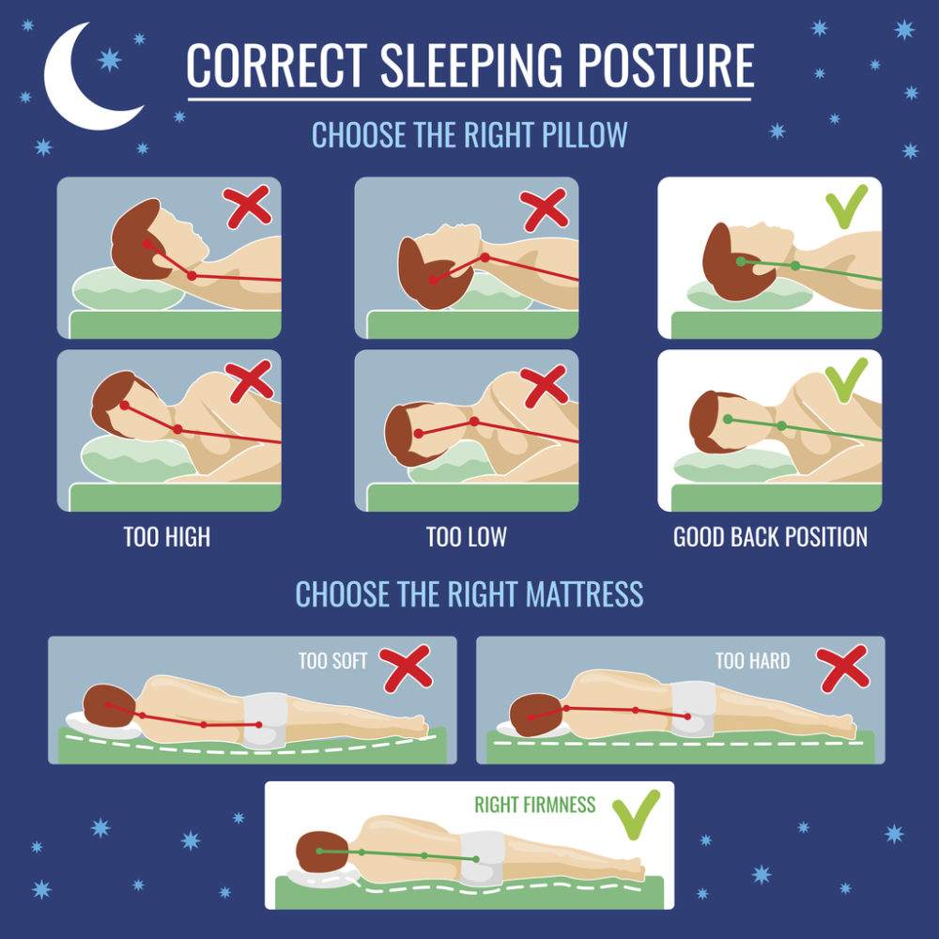
Bed and Head: Pillows
Goal is neutral head position
Generally avoid prone sleeping position

Slide 14
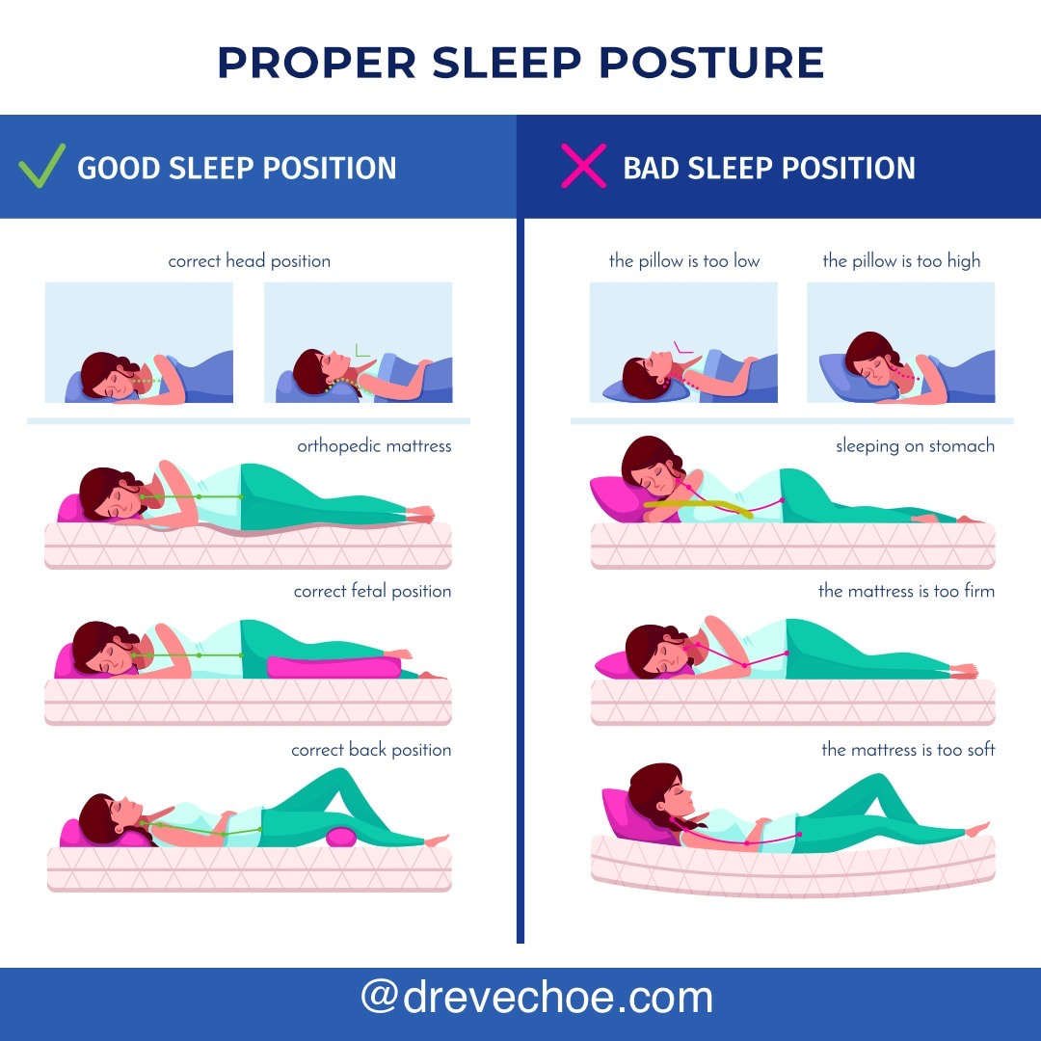
Bed and Head: Bed
HGNS highly sensitive to position

Slide 15
Lengthen and Strengthen
Stretching
  Child’s yoga pose
  Chest stretch
Shoulder strengtheners
  Scapula squeezes (squeezing your shoulder blades together for 30 seconds at a time)
  Rows (using a resistance band to pull back your elbows like you're rowing).
Core strengtheners
  Modified planks (in which you hold a push-up position while propped up on your elbows)

Slide 16
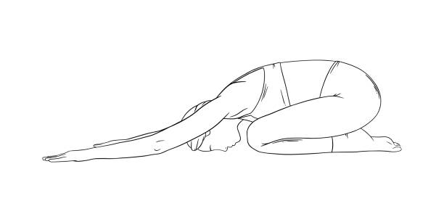
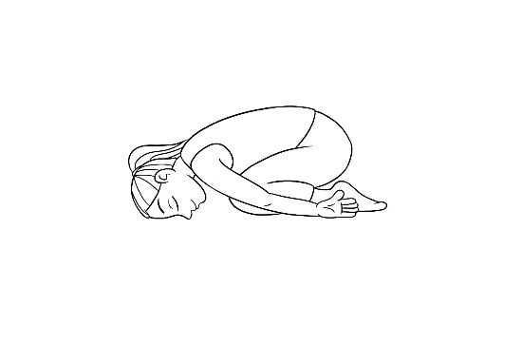
Child’s Pose
stretches and lengthens your spine, glutes, and hamstrings
Sit on your shins with your knees together,
Walk your hands out in front of you.
Sink your hips back down toward your feet
Gently place your forehead on the floor
Keep your arms extended or rest them along your body.
Breathe deeply into the back of your rib cage and waist.

Slide 17
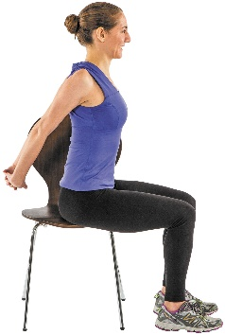
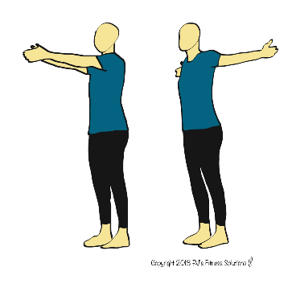
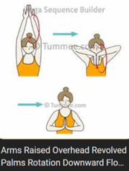
Chest Opener/ Shoulder Squeeze/Overhead
Stretches pectoralis and reduces forward posture
Stand with your feet about hip-width apart.
Bring your arms behind you and interlace your fingers with your palms pressing together
Keep your head, neck, and spine in one line as you gaze straight ahead.
Inhale as you lift your chest toward the ceiling and bring your hands toward the floor.
Breathe deeply as you hold this pose for 5 breaths.

Slide 18
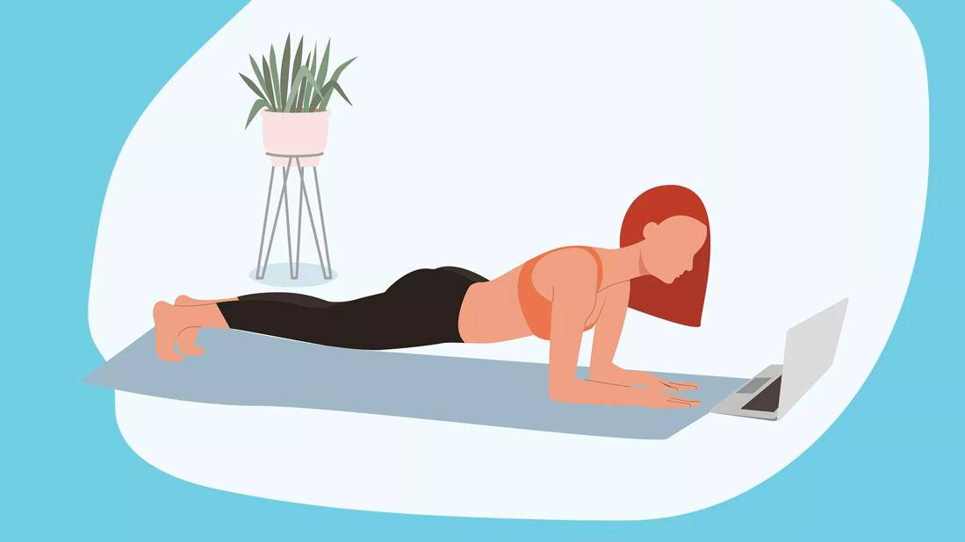
Planks
Traditional High Plank
  Pushup position lift body off the ground and hold For proper form:
  Elbows are directly underneath your shoulders.
  Glutes are engaged Core is tight.
  Hold in your belly muscles. Back and butt are straight not sagging or sticking up in the air.
Modified plank:
  Start in a pushup position. Drop your knees to the floor and hold your position.
Low plank:
  Upgrade to a low plank. Just lift your knees and rest on your elbows

Slide 19
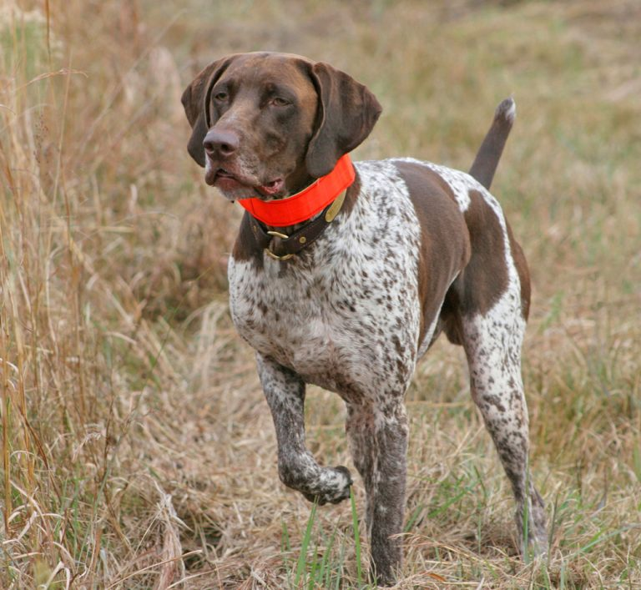
Bird Dog
Point one arm out straight in front and extend the opposite leg straight behind. Keep your hips squared to the ground. If your lower back begins to sag, raise your leg only as high as you can while keeping your back straight.
Hold for a few seconds, then return to your hands and knees. Keep abs engaged and minimize extra motion
Switch to the other side.

Slide 20
Summary
Good posture is critical for good health
One of the missed benefits is affect on breathing, snoring, sleep apnea
Reduce the risk of aging

