Slide 1
Lifestyle and OSA Outcomes
B Tucker Woodson MD
Professor and Chief Division of Sleep Medicine and Sleep Surgery
Department of Otolaryngology
Medical College Wisconsin
Milwaukee WI, USA

Slide 2
Sleep Apnea and Wellness
Obstructive sleep apnea has strong associations with multiple disease outcomes
Snoring
Qol
Medical morbidity
HTN
Stroke
Diabetes

Slide 3
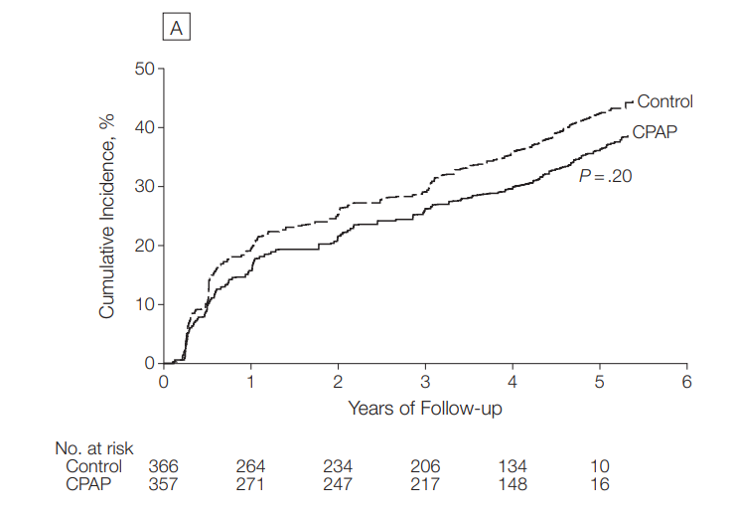
Sleep Apnea Treatment and Wellness (Hypertension)
No effect on non-sleepy HTN

Slide 4
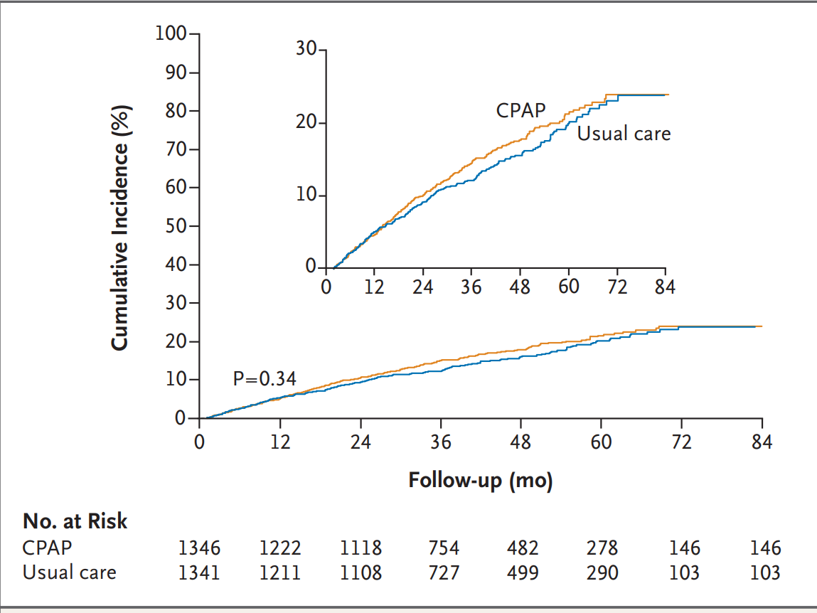
Sleep Apnea Treatment and Wellness (major Cardiovascular)
N=2717, age 61Y, BMI 29, AHI 29 events/hr
No significant effect

Slide 5
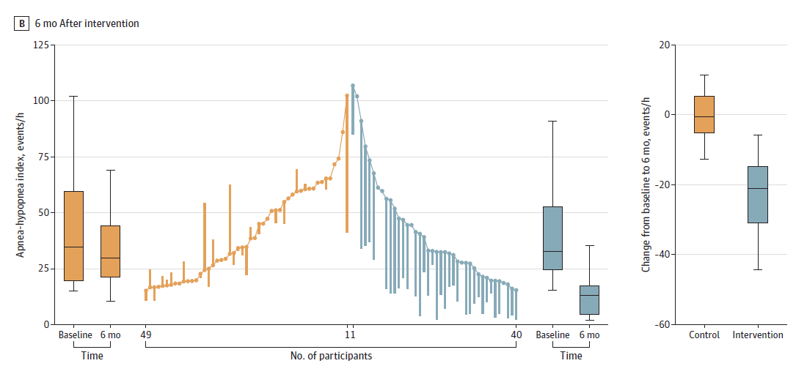
Sleep Apnea Treatment and Wellness (The Interapnea Trial)
N=89 fu at 6 month, weight loss, exercise. diet, Etoh, smoking cessation
All on CPAP

Slide 6
Sleep Apnea Treatment and Wellness (The Interapnea Trial)
7% weight loss, 9 km/day, 45% no longer required CPAP, (study ended in Covid)

Slide 7
Wellness and Sleep Apnea
Deliberate activities, choices and lifestyle to attain better physical and mental health outcomes

Slide 8
Lifestyle and OSA
Weight management
Diet
Exercise
Alcohol
smoking

Slide 9
Conclusion
OSA not really very important disease
OSA important but treatment with CPAP is ineffective
Patient selection is bad
Treating a single metric (AHI) in a multifactorial disorder is meaningless

Slide 10
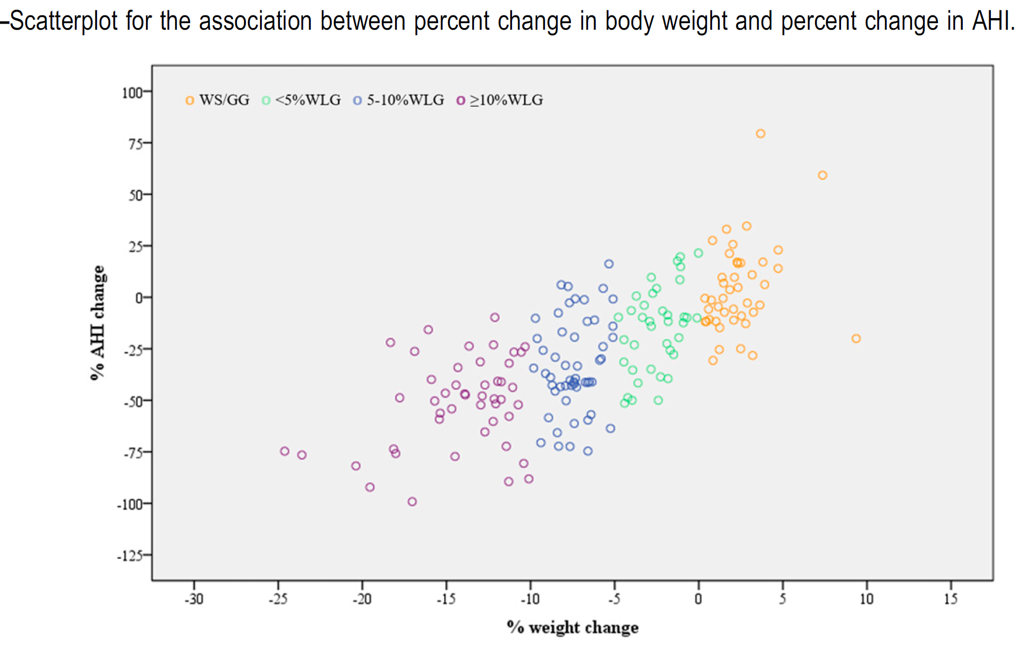
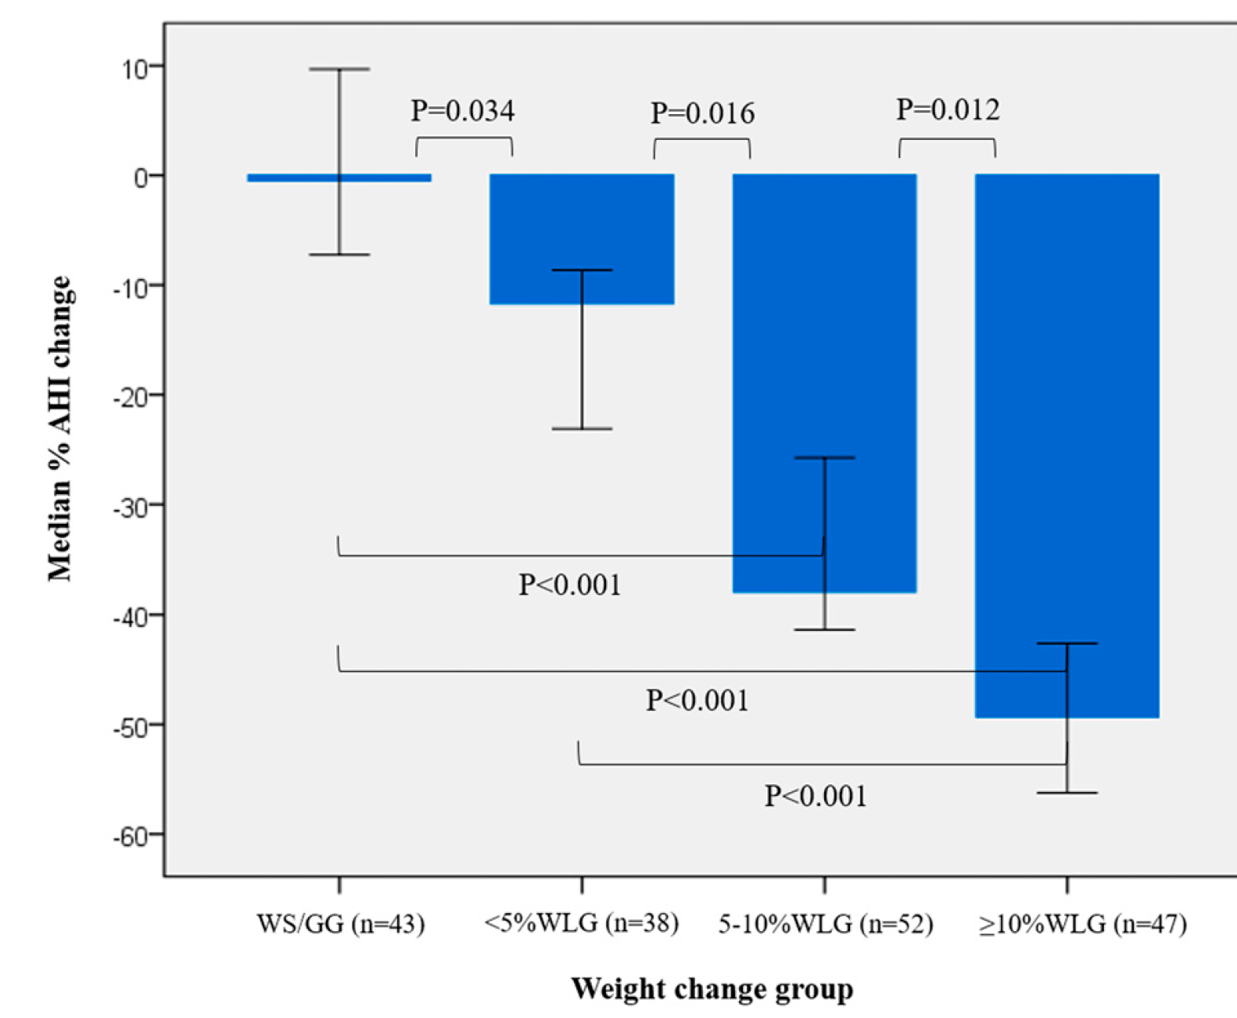
Weight / Diet
N=180, 6 month, Mediterranean diet
10% weight loss

Slide 11
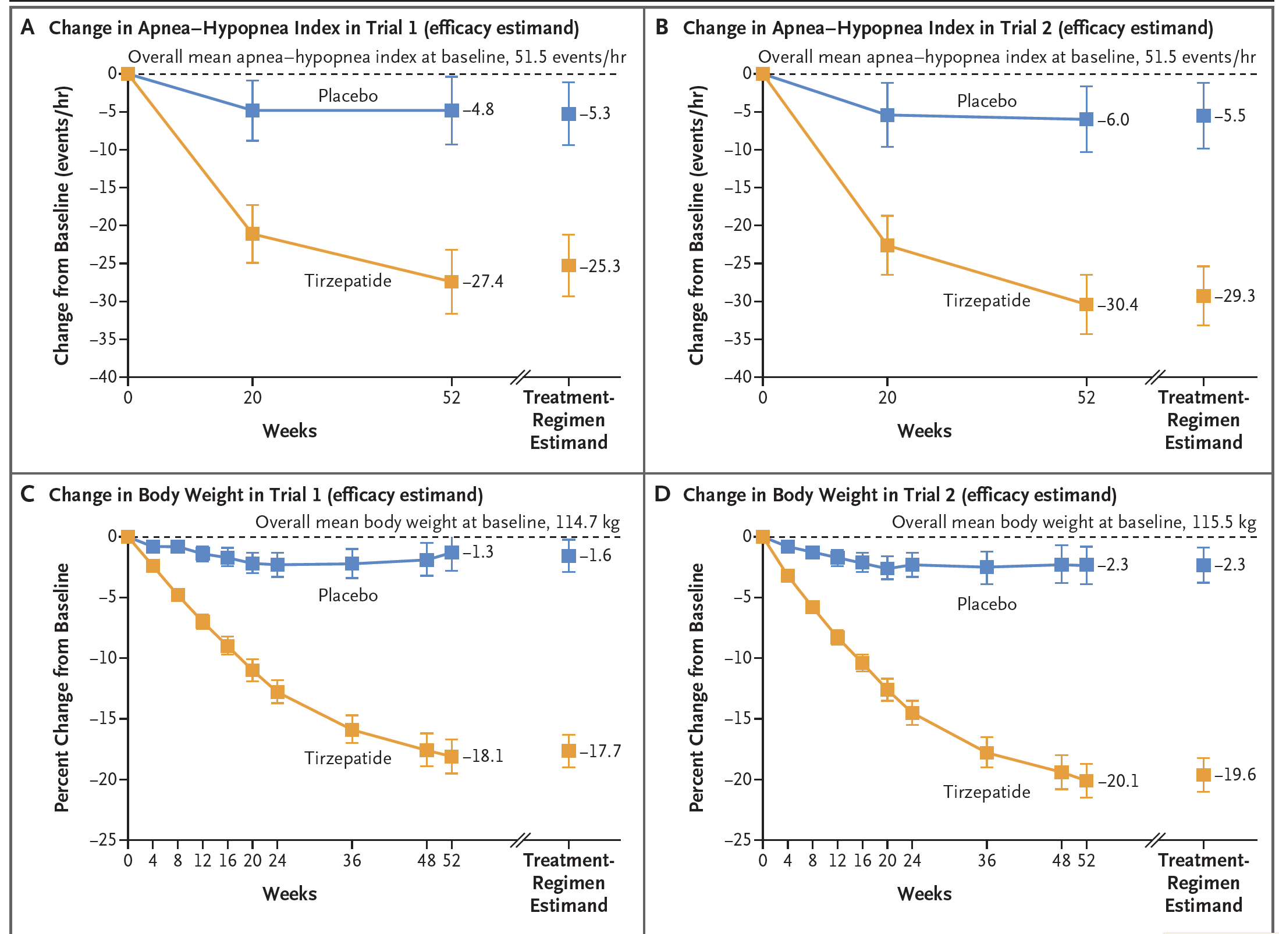
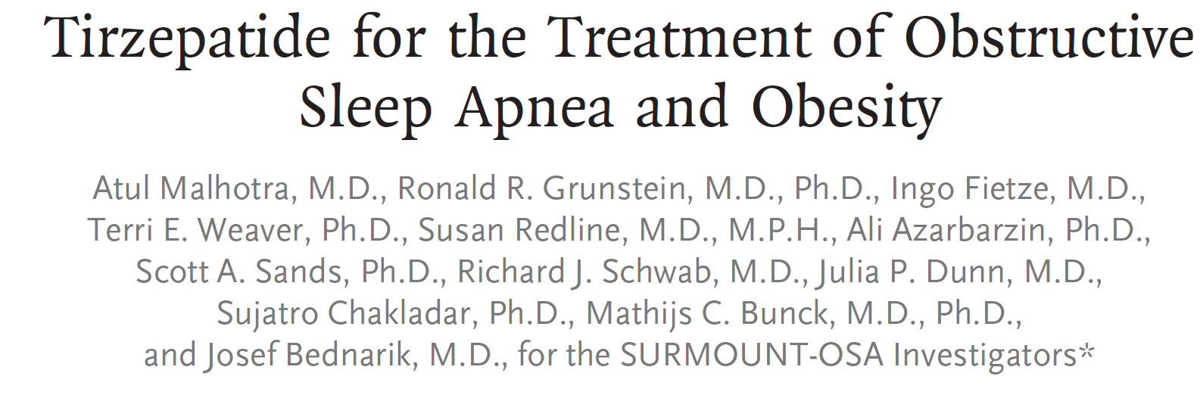
Weight / Diet (GLP1 agonist)
17% weight loss at one year

Slide 12
Weight / Diet (GLP1 agonist)
17% weight loss at one year

Slide 13
Weight / Diet (GLP1 agonist)
CPAP + weight loss = no improvement

Slide 14
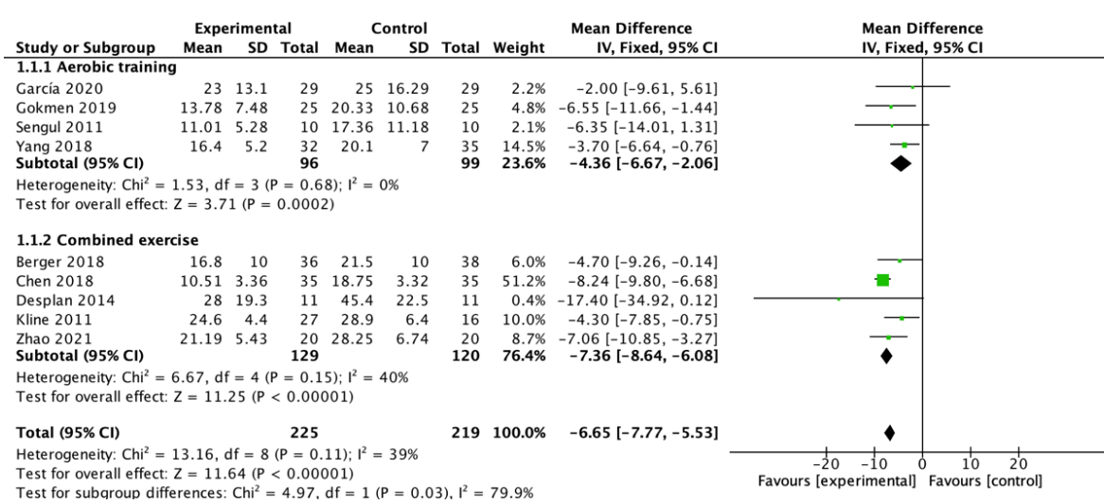
Exercise/Physical Activity
−6.65 events/h (95% CI −7.77 to −5.53; p< 0.00001)
Aerobic and resistance training with larger effect

Slide 15
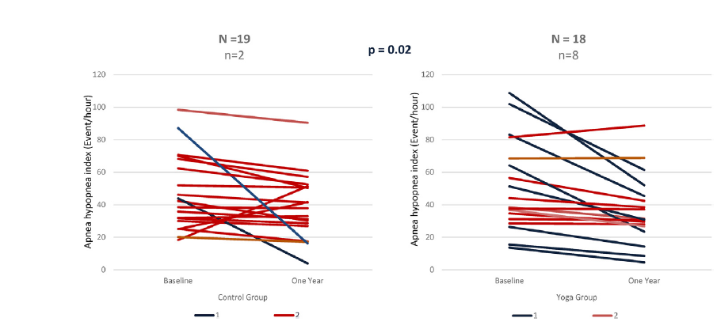
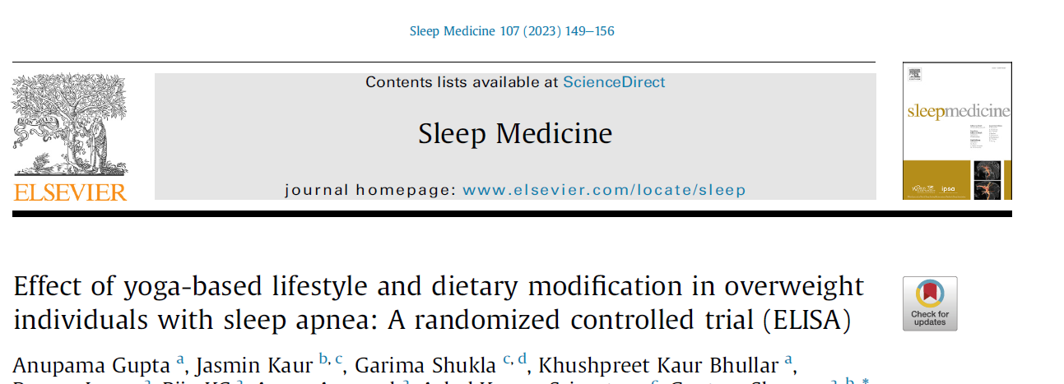
Exercise (yoga)
Asanas (postures), pranayama (breathing techniques), and dhyana (meditation) for at least 45 min/day
45-60 focused exercise and weekly counseling
No weight loss

Slide 16
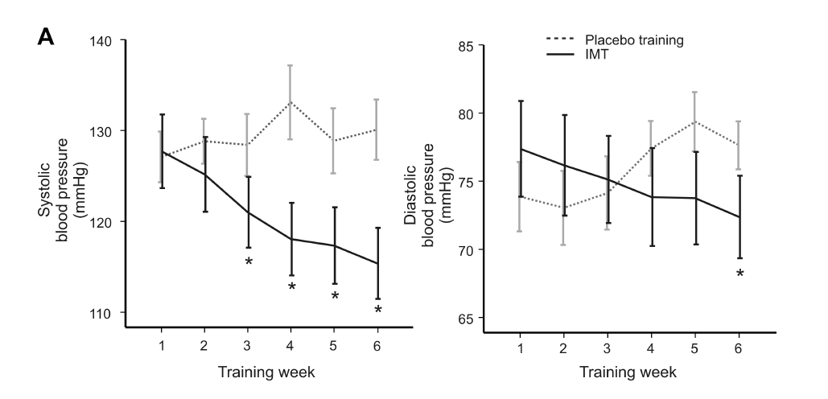
30 breaths each day for 6 w using an inspiratory threshold training device (K3 series, POWERbreathe, Warwickshire, UK
Treatment group ~75%Pimax Placebo ~15%PImax

Slide 17
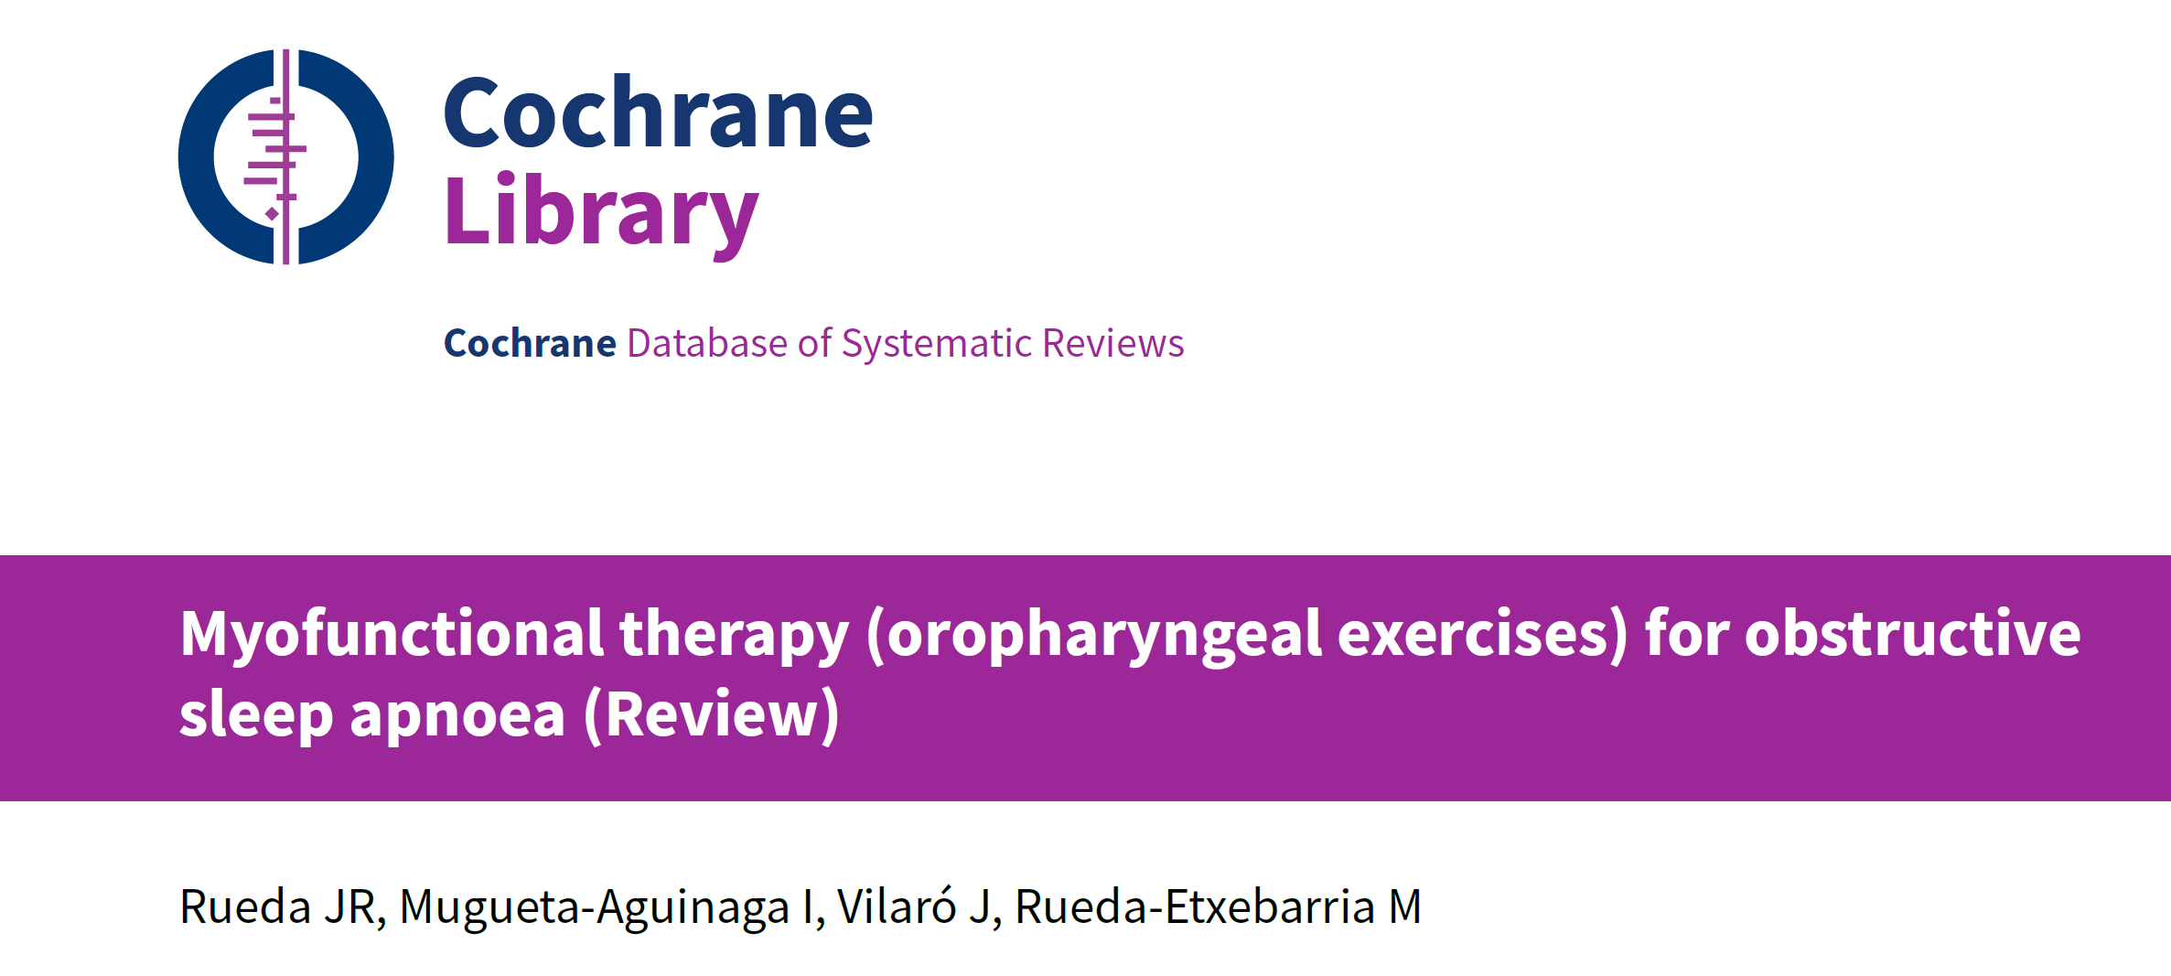
Myofunctional Therapy
Myofunctional therapy teaches people to do daily exercises to strengthen their tongue and throat muscles
Compared to sham low quality evidence

Slide 18
Myofunctional Therapy App for Severe Apnea–Hypopnea Sleep Obstructive Syndrome: Pilot Randomized Controlled Trial
O'Connor-Reina, C et al

Slide 19
Muscle Strengthening and OSA
Anecdotal report
Small insignificant change AHI (n=18)

Slide 20
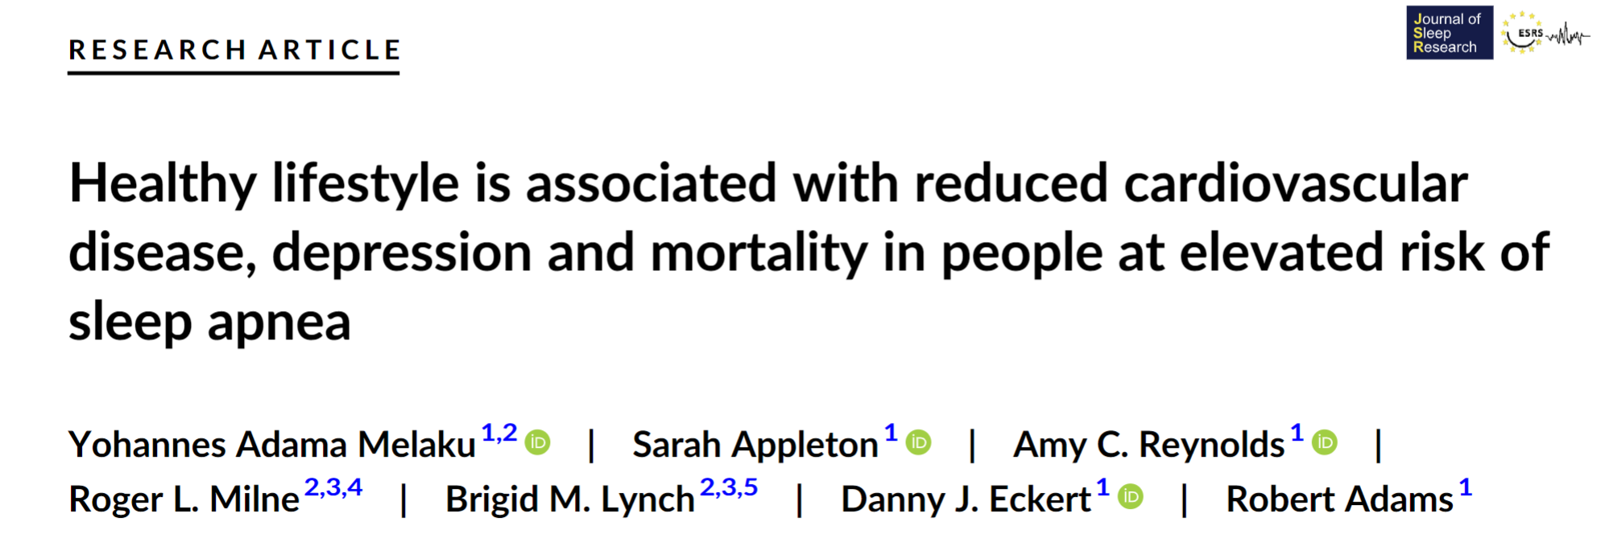
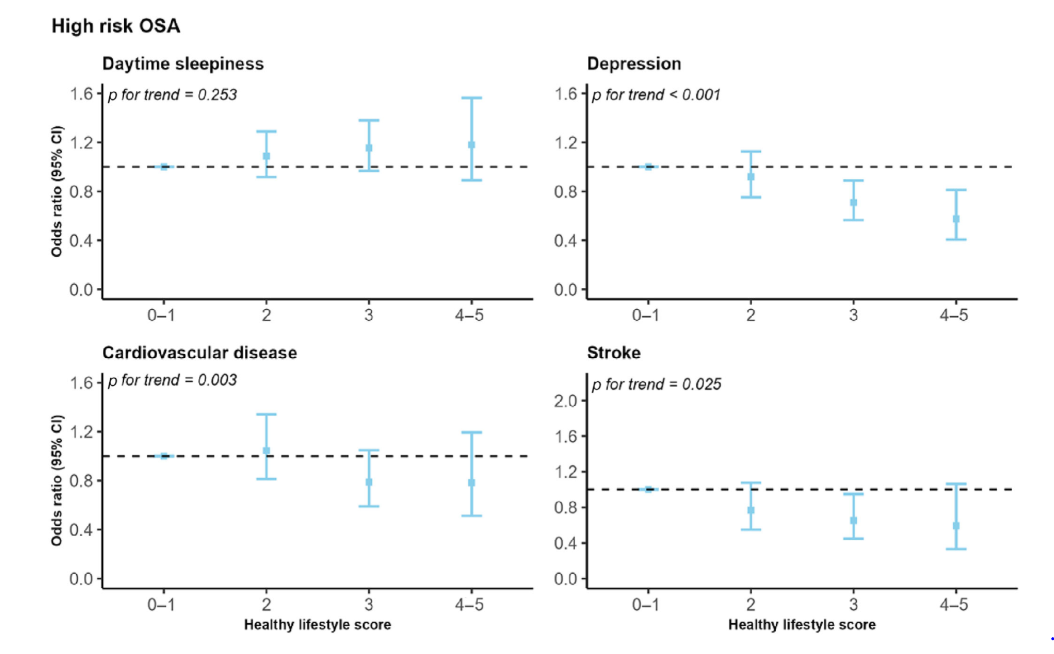
Alcohol
Effect on health, snoring, AHI, sleep
No change GGemg but may be Rnasal or arousal

Slide 21
Conclusion
OSA treatment has effects on OSA outcomes
Wellness has greater impact on health in OSA patients than OSA treatment alone
Rank
Obesity ++++++++
Exercise +++
Others +/-

