Slide 1
Supporting youth mental health by building resilience
Notes:
Welcome! We are here today for the workshop, “Supporting Youth Mental Health by Building Resilience.”
Presenters and tech support introduce themselves and connection to mental health.
During the next 1-2 hours, I would like to challenge everyone to give yourself the gift of learning and focused time with your colleagues. Put your phones away and close any open windows on your computer. Let’s get grounded and ready. (optional: deep breath or quick stretch.)
This presentation is part of a grant funded by the Advancing a Healthier Wisconsin Endowment from the Medical College of Wisconsin. Ten communities in Wisconsin received grants like this – we are all working toward improving behavioral health in our local communities. Our local community coalition for the project consists of more than 20 organizations between Chippewa and Eau Claire counties. Our goal is to increase youth resilience, which we will learn more about during the presentation.
Slide key points:
Introduce yourself and share your background
Provide information about Mental Health Matters

Slide 2
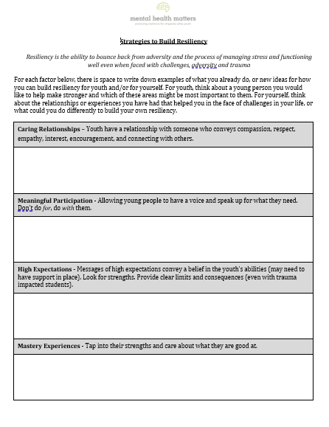
HOUSEKEEPING
Handouts are available in google drive (link provided)
“Strategies to Build Resilience” worksheet – have available
Please participate with your camera on
Workshop is not recorded
Notes:
We’d like to review a few housekeeping items for this virtual workshop to help everyone make the most of our time together.
Handouts are available in google drive. A link was emailed prior to today’s workshop. We will also include the link in the chat: Handouts - https://drive.google.com/drive/folders/1D7gIhaIKw4e-y60GLtFkEEHJuCTEqWTf?usp=sharing.
One of the handouts to have available today is the “Strategies to Build Resiliency” worksheet. It is available in the google drive folder and was also emailed as an attachment. This worksheet will be useful to write notes during the second half of this workshop. If you don’t have it now, you will have time during a break to get the handout.
Please leave your videos ON for active participation in the workshop.
Today’s workshop will not be recorded.
Slide key points:
Reminder about access to workshop handouts and printing worksheet
Review virtual workshop etiquette

Slide 3
HOUSEKEEPING
Private comments to other participants can be viewed by host at the end
Use mute when not actively speaking
Use raise hand or chat feature to minimize over-talking
A break will be provided during workshop
Notes:
Please note private comments may be viewed by the host at the completion of the workshop. Just a heads up.
Please use the mute button when you are not actively speaking. When you would like to share comments or questions, please unmute yourself and say your name when you begin speaking.
Use the raise hand or chat feature. This will help to minimize talking over one another.
There will be about a 10–15-minute break between the two parts of the workshops.
Slide key points:
Review virtual workshop etiquette
There will be a break

Slide 4
objectives
Define adverse childhood experiences and describe ACE study findings of the impact of ACEs on physical and mental well-being
Identify mechanisms for how toxic stress and trauma impact the developing brain
Describe and define resilience and the protective factors that build resilience & support improved youth mental health
Identify specific strategies or actions to take in our work with youth to develop and strengthen their resilience
Describe the relationship between our own resilience/self-care and building resilience for youth
Notes:
Optional slide.
Slide key points: Review workshop objectives

Slide 5
Part 1: ACEs and Health Part 2: resilience
Notes:
Today’s workshop, “Supporting Youth Mental Health by Building Resilience” is divided into two parts.
Part 1 ACES and Health– We will talk about Adverse Childhood Experiences (or ACEs) and how traumatic experiences affect youth mental health. Part 2 Resilience – We will focus on the how to provide youth with tools and support to overcome adversity. This is about resilience – or the ability to bounce back from difficult life situations.
We will talk about how we (as youth serving professionals) can support youth in being resilient. We will think critically together about the information provided and determine action steps that can be taken.
And we will talk about why our own resiliency is so important in our work with youth.
Slide key points: Review two parts of the workshop

Slide 6
Part 1: ACEs and Health
Information on ACEs can be anxiety producing for some. Please feel free to step away at any time during this presentation if you need to.
Notes:
Let’s go ahead and get started with Part 1 – “Adverse Childhood Experiences and the effects on youth mental health”.
Please know learning ACE information can be difficult for some people and if they feel uncomfortable with the material they can step away. If you need support, please contact the tech person (provide name) in a private chat.
Before we dig in, let’s get an idea of how familiar you are with adverse childhood experiences (ACES)?
***POLL: How familiar are you with adverse childhood experiences (ACES)? - not at all, - somewhat, - I’m an expert
***And/or please share one thing you know about ACEs and mental health in the chat box. Read a few of the examples and validate.
Slide key points:
Inform audience they can step out at any time if they need to
Part 1: ACEs
Assess audience ACE knowledge

Slide 7
What are ACEs?
ACEs = Adverse Childhood Experiences
Negative life events or experiences that occur during childhood
Can interfere with healthy child development
ACEs are sometimes referred to as toxic stress or childhood trauma
Notes:
Let’s talk more about what ACEs are.
- ACEs are Adverse Childhood Experiences
- They are negative life events that occur during childhood
- ACEs can interfere with healthy child development and can lead to negative health outcomes in adulthood
- ACEs are sometimes referred to as toxic stress or childhood trauma
Slide key points:
Definition of ACEs
Connection to other terms that may be more common (toxic stress, trauma)

Slide 8
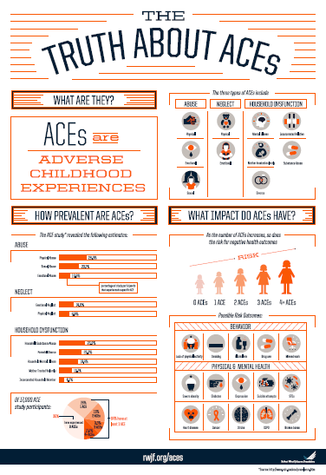
The ACE Study
The most important study you’ve (probably) never heard of
ACEs Video
Notes:
HANDOUT - The Truth About ACEs (In the google folder)
To get us started, let’s look at the ACE study. This has been described as “The most important study you’ve (probably) never heard of.”
OPTIONAL VIDEO TO SHARE: ACE study video https://vimeo.com/139998006 This five-minute video does a nice job of defining ACEs and describing the key questions asked and important findings of the ACE Study.
ACE study description (don’t need if using video): Origin of ACE study: “In the mid 80s, Dr. Vincent Felitti, director of a Kaiser Permanente weight loss program, made an unexpected clinical observation: program participants who were most successful were also most likely to drop out of the program. In follow-up interviews with many of these participants, Dr. Felitti discovered that child sexual abuse and/or physical abuse was common, and the abuse typically preceded the onset of obesity. He concluded that obesity was not the real problem, and that many participants had used it as a solution for coping with more severe problems they could not talk about. Dr. Felitti teamed up with Dr. Robert Anda at the CDC to further explore this connection, leading to a partnership that becoming the ACE study.”
Slide key points:
Handout the Truth about ACEs (located in google docs)
Describe ACE study – optional use of ACE video or verbally describe
Optional: tell story of origin of ACE study

Slide 9
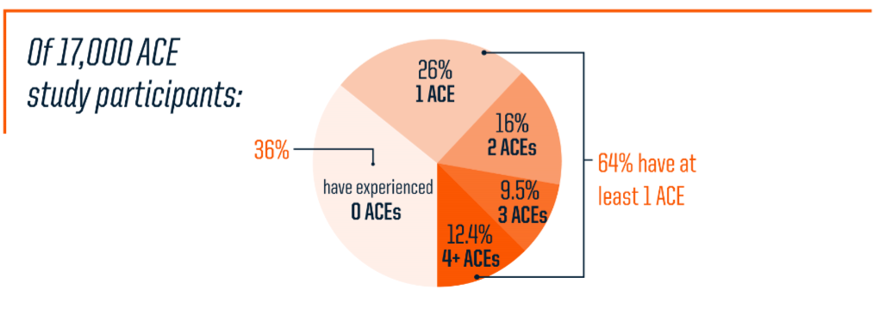
So What? ACE Study Results #1
ACES are very common!
Notes:
The handout “The Truth About ACEs” summarizes key points about ACEs that were covered in the video. Both the video and handout include information from the original ACE study, which highlighted 2 main findings.
The first is that ACEs are very common. In the original ACE study, of the more than 17,000 middle-class, college-educated, majority-white, employed people with health insurance who participated, 64% of study participants had experienced at least 1 of those 10 types of childhood adversity, and more than 1 in 5 people reported having 3 or more ACEs.
Slide key points:
ACEs are very common. Also, most people with 1 ACE, also have others
Majority of study population was white, middle-class with health insurance

Slide 10
So What? ACE Study Results #2
Notes:
The second main finding is that ACEs are linked to many negative health outcomes later in adulthood, including chronic disease, risk behaviors like excessive smoking and drinking alcohol, and impaired mental health.
The study found that as the number of ACEs increases, the risk for negative health outcomes also increases – this is called the dose response relationship. Let’s take a look at this more closely.
Slide key points:
ACEs are linked to many health outcomes – mental, physical, and risky behaviors

Slide 11
ACE Study Results
Dose-response relationship
As the number of ACEs increases…
(the dose)
…the risk of occurrence of health conditions also increases
(the response)
Response increases
If 4+ ACES…
2x more likely to smoke
12x more likely to have attempted suicide
7x more likely to be alcoholic
10x more likely to have injected street drugs
Dose increases (# of ACEs)
Notes:
The pattern you see here was the same for multiple conditions and behaviors in the ACE study. As the number of ACEs increased, or the dose, the risk of occurrence of health conditions, or the response, also increased. This finding was critical. It showed that the original hunch of the ACE study not only proved correct for obesity, but that the pattern was the same for many other health outcomes and behaviors.
And importantly, people who reported having the most ACEs, specifically those with 4 or more ACEs, were at the highest risk for being unhealthy.
Compared to people who had none, people with four or more ACEs were twice as likely to be smokers, 12 times more likely to have attempted suicide, 7 times more likely to be alcoholic and 10 times more likely to have injected street drugs.
With an impact on so many health conditions, the ACE study highlights the great opportunity of ACE prevention to improve the overall health and well-being of whole communities.
Slide key points:
The more ACEs someone has, the more likely they will experience negative health outcomes.

Slide 12
Early
Death
Death
Disease, Disability, Social Problems
Child adversity has a negative long-term impact on health and wellbeing
Services, support, and resilience CAN change this life course!
Adoption of Health Risk Behaviors
Social, Emotional, Cognitive Impairment
Disrupted Neurodevelopment
Adverse Childhood Experiences
Conception
Mechanism by which Adverse Childhood Experiences Influence Health and Well-being Throughout the Lifespan
Notes:
The ACE pyramid pictured here was developed from the ACE study and gives a framework for how adverse childhood experiences impact the life course from birth to death. The diagram links adverse experiences early in life to brain changes and resulting social, emotional and cognitive impairment up to the adoption of health-risk behaviors, and ultimately poor health. The pyramid shows how intervening earlier and focusing on preventing or mitigating the effect of ACEs, could stop later risk behavior and poor health outcomes.
Often, we start to address risk behavior once we can see it in someone, but prior to that, changes are happening to the brain resulting in impaired social, emotional and cognitive functioning – for youth this could mean it is hard to focus in class or to make and keep friends. When this happens, kids may turn to risky behaviors to help them cope. So what if we did something to intervene earlier in this process?
As the shape of the pyramid suggests, adverse childhood experiences do not guarantee bad outcomes, but they greatly increase the odds of struggle. Services, support, and resilience CAN change this life course!
Slide key points:
The ACE pyramid depicts how ACEs impact health across the lifespan, starting with changes to the brain early in life.
The pyramid, and the gaps between the layers, show where this can be interrupted.

Slide 13
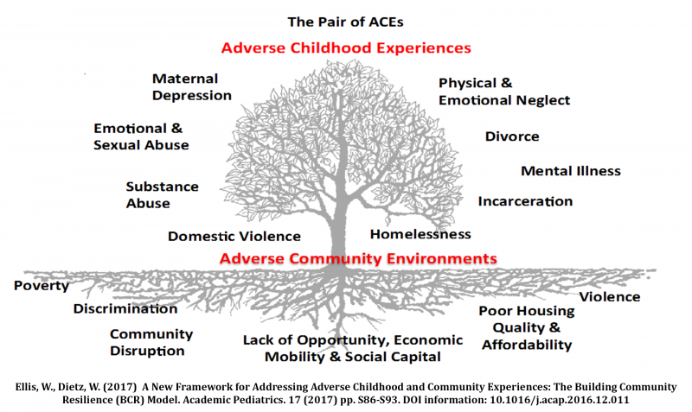
What was NOT measured in the ACE study…
Exposure to community violence
Racism
Discrimination
Living in foster care
Historical trauma
Trauma is historical, structural, and political
Notes:
As mentioned, the ACE study participants included people who were mostly white and middle-class with health insurance. The study measured 10 adverse experiences but didn’t look at some of the other adversities experienced by people that we know also impact health, such as poverty, racism, or historical trauma. New models of childhood and community adversity look at preventing traumatic experiences for individuals, as well as at the system and community level. Trauma informed care models recognize these additional adversities and setbacks that many face that were not measured in the original ACE study. (Presenters see additional references on impact of racism, historical trauma, etc.)
Slide key points:
ACE study and questionnaire asks about 10 adverse experiences in childhood in a study population that was mostly white, middle-class, with health insurance.
Other studies have examined adverse experiences not measured in the ACE study, both at the individual level (e.g., death of a parent) and systems level (e.g., poverty, violence), and observed a similar impact on health outcomes.

Slide 14
ACEs in Our Community
Notes:
The ACE study was completed in 1998, and since then many states, including Wisconsin, have started collecting ACE information for the adult population and have found similar results to that of the original study. We even have local data for our community about ACEs.
This chart shows the rate of ACEs reported by adults participating in the Behavioral Risk Surveillance System. Comparisons for national, state, and region are included. You can see that the number of ACEs experienced is similar for adults in our region compared to all of Wisconsin and the nation.
As we learned in the previous slide, with an ACE score of 4 or more, poor physical and mental health outcomes increase dramatically. In the Chippewa Valley, about 1 in 6 adults report having 4 or more ACEs.
Slide key points:
ACEs questions are now being asked in many different population level surveys (like the national Behavioral Risk Surveillance System) nationwide, including in Wisconsin.
In our area, half of adults in our region report having at least 1 ACE, and 15% (or about 1 in 7) report having 4 or more and are at increased risk for many poor health outcomes.
Note for presenters:
National figures from CDC Behavioral Risk Factor Surveillance System 11 questions(2011-2014 combined results) https://www.cdc.gov/violenceprevention/acestudy/pdf/BRFSS_Adverse_Module.pdf https://www.cdc.gov/violenceprevention/aces/ace-brfss.html?CDC_AA_refVal=https%3A%2F%2Fwww.cdc.gov%2Fviolenceprevention%2Facestudy%2Face-brfss.html
Wisconsin adults from WI Behavioral Risk Factor Survey 11 questions https://preventionboard.wi.gov/Documents/ACE-Brief_2018FINAL.pdf. 2017-2019 summary results presented here
CV adults from WI Behavioral Risk Factor Survey 11 questions – 2017-2019 combined results

Slide 15
The Science of ACEs
Notes:
Transition slide:
So now that we know what ACEs are and what the long-term effects can be, let’s take a look at the in-between – the how.
HOW do adverse childhood experiences impact behavior and health – both physical and mental health?

Slide 16
Early Connections
Baby & Parent Video
Notes:
Babies are born with billions of brain cells at birth, but they are not connected. You can see how the brain makes more and more connections from birth to the age of 6 months. The wiring of the brain is dependent on our experiences. What gets experienced the most leads to the strongest connections between nerve cells. Over time, these connections form intricate and complex networks. The more a person (repeatedly) practices or learns something, the stronger the connections -- whether positive or negative. The more we do things or think about things the same way, the stronger the connection. This is how the brain gets wired.
As an example, can you tell me what usually happens when a baby cries? (Audience answers – pick up baby, sooth baby, provide comfort). What is the baby learning? The baby in this case is wiring the positive experience of having his needs met based on his cry. And what would a baby do if he isn’t picked up? (Audience answer – cries more, etc.) And what is a baby learning in this instance? After awhile the baby will learn that it doesn’t get what it needs with crying and may stop all together. In this case, it is the negative experience that is wired, and what the baby comes to expect as a response to his cries.
OPTIONAL VIDEO TO SHARE: If time, show “still face experiment video” (baby & parent video) -- 2 minutes 48 seconds. Video reinforces baby crying example.
Slide key points:
Early in life, the brain experiences rapid development as neural connections are made.
What is experienced – whether positive or negative – early in life is what gets developed as neural pathways are created.
Video or baby crying example (or both)

Slide 17
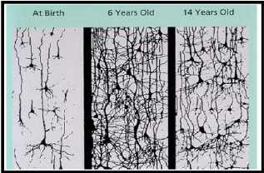
Pruning
Pruning Video
Notes:
In the first few years of life, millions of neural connections are formed as a baby grows and learns. After this period of rapid proliferation, connections are reduced through a process called pruning, which allows brain circuits to become more efficient. Through pruning, the least “experienced” connections are the ones that tend to withdraw. Therefore, if you have lots of positive experiences, the brain naturally prunes negative experiences. The opposite is also true. The more negative experiences that occur, the brain is more likely to let go of positive experiences. Thinking about the example of the crying baby who didn’t get picked up or soothed – when pruning happens, what has been experienced will be preserved – the negative connection is the one this child will keep. The early years are the most active period for establishing neural connections, but new connections can form throughout life and unused connections continue to be pruned.
OPTIONAL VIDEO TO SHARE: This short video summarizes what we’ve covered in the past couple of slides, including pruning, and how all of these early process impact how the brain functions. https://developingchild.harvard.edu/science/key-concepts/brain-architecture/ (video is 1 minute 56 sec)
Slide key points:
Brain connections that are used more grow stronger and more permanent, while connections that are not fall away, through the natural process of pruning.
If positive experiences are not developed and fall away through pruning, the brain does not develop as expected, which can lead to disparities in learning and behavior.

Slide 18
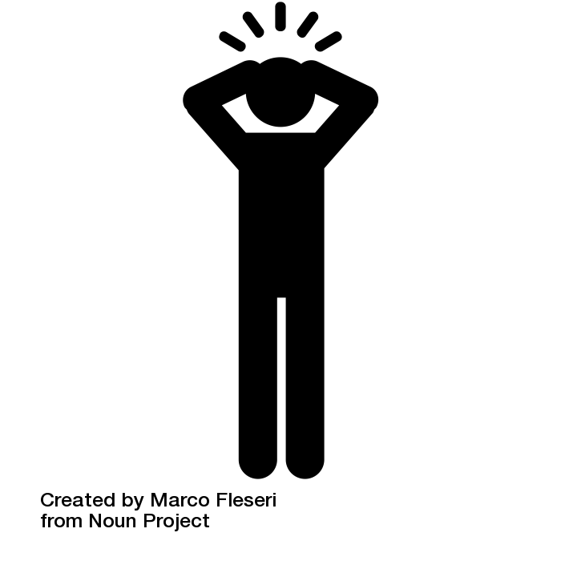
Childhood Stress
Hyper-responsive stress response
Decreased calm/coping
Chronic “fight or flight”
Increased cortisol/norepinephrine
Changes in brain architecture
Notes:
Brain science shows that, in the absence of protective factors, toxic stress damages children’s developing brains. Experiencing stress is an important part of healthy development. When we are threatened, we have a very efficient fight or flight system that begins with a signal from the amygdala that tells the body to release a flood of stress hormones (adrenaline, cortisol). This response shuts off the thinking portion of the brain that would stop to consider other options. Even during the normal stress response, it can take an average of 20 minutes to calm down or recover. (Examples to possibly share include 1. If a couple is arguing and takes just 10 minutes to cool down, that is likely not enough time and coming back to the discussion too early can mean the conversation becomes heightened again right away or 2. Often on the playground when two kids get into an argument or fight, they are pulled together right away to apologize or resolve the issue, and staff can get frustrated when they can’t get there. Kids would be better able to after a longer cool down period)
If something threatens a child every single day, the emergency response system is activated over and over and over again, and the amygdala is hijacked. The child is always ready to fight or flee, but the part of his brain – the prefrontal cortex – that’s called upon to diagram a sentence or do math becomes stunted, because, in our brains, emergencies take precedence over doing math.
Children with toxic stress live much of their lives in fight, flight or fright (freeze) mode. They respond to the world as a place of constant danger. With their brains overloaded with stress hormones and unable to function appropriately, they can’t focus on learning. They may fall behind in school or fail to develop healthy relationships with peers or create problems with teachers and principals because they are unable to trust adults. Some kids do all three. Also, the elevated levels of cortisol suppress the immune system, which leave them susceptible to disease so there is a physical impact as well.
Slide key points:
Stress response system is normal, but negative changes occur to brain development when someone experiences constant stress, making it difficult to cope and learn.
When experiencing toxic stress, a child may eventually turn to risky ways of coping with the stress, like drug or alcohol use.

Slide 19
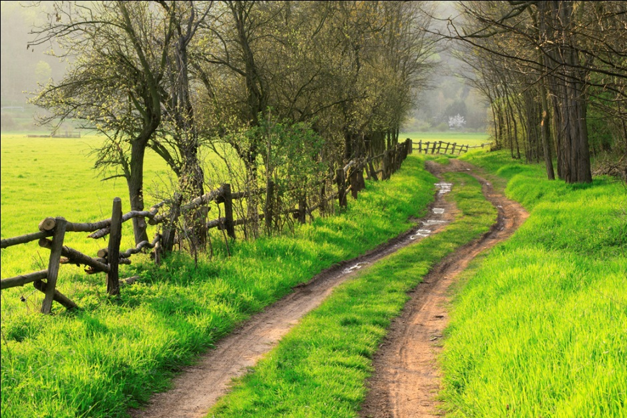
Changing Course
Neuroplasticity Video
Notes:
A pattern in childhood of chronic negative experiences and the resulting unhealthy coping mechanisms is hard to overcome. The longer a child has been exposed to certain behaviors or feelings, the deeper the grooves in the path (the wiring of the brain) and the more difficult it is to change (Oregon trail).
The good news is that the brain continually changes its wiring in response to the environment. If toxic stress stops and is replaced by practices that build resilience, the brain can slowly undo many of the stress induced changes and return to baseline. It becomes possible to create new pathways, and “jump the fence”. Providing help and support to kids and their families and repeated different experiences can lead a child to trust, heal and gain the skills to have different relationships.
OPTIONAL VIDEO TO SHARE: This video covers developing pathways in the brain and provides a transition to talking about resiliency. It summarizes good news about our brain’s ability to adapt and change. (Video is 2 minutes 3 seconds)
https://www.bing.com/videos/search?q=Neuroplasticity+video&view=detail&mid=9E23EDD016E284619D7A9E23EDD016E284619D7A&FORM=VIRE
Slide key points:
What is experienced is what is developed, and these pathways can be hard to change.
It is possible to “jump the fence” with support and practices that work to create healthy coping and build resilience.
Optional Video - neuroplasticity

Slide 20
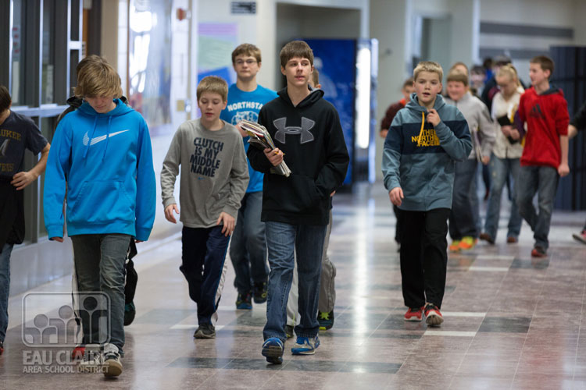
ACEs in Our Work
What are some markers you have seen that potentially identify kids with high ACEs?
What have you done to help kids with ACEs?
What do you wish you would have done differently?
Notes:
At this point, we are going to use breakout rooms to discuss the questions on this slide, followed by a 10-minute break. The questions you see will be included in the chat for reference. In the CHAT: What are some markers you have seen that potentially identify kids with high ACEs? What have you done to help kids with ACEs? What do you wish you would have done differently? During your 5-minute group discussion, type 1 or 2 things you talked about in the chat, and we’ll look at those when we come back after the break. ** Reminder: if you don’t have the “Strategies to Build Youth Resiliency” handout, please use time during the break to print it out. If you do not have a printer, please have a blank piece of paper available for Part 2. Go ahead and discuss 3 questions for 5 minutes, take a quick 10-minute break, and we will reconvene at (indicate the time to resume).
Presenters: If there are 10 or more participants, use breakout rooms with groups of 5 or fewer per room. Let participants know that co-presenters might pop in the chatroom and will bring them back to the large group after 5 minutes. During the break, review the chat and look for one or two comments to highlight after the break. Reconvene group after 10 min and read comments. Ask if anyone has anything else to add. Transition to Part 2 by highlighting their examples of how they are already helping kids build resilience.
Slide key points:
Through the activity, participants begin to identify what they already see and do about ACEs in their work/life.
Transition to Part 2 by emphasizing examples of what the group already does to help kids – moving to build resilience.

Slide 21
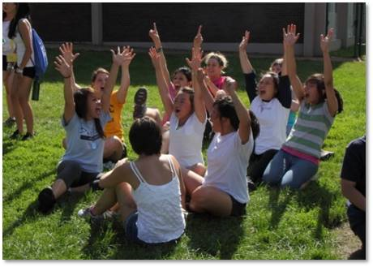
Part 2: resilience
Notes:
Now let’s shift gears and learn that ACEs are NOT our destiny.
In recent years, we’ve learned from research about RESILIENCE, or the ability to bounce back from adversity, and how resiliency can lessen the impact of ACEs.
In Part 2, we will learn about protective factors that we can promote in our work with young people and as a community to help young people build resiliency, overcome adversity, and face challenges.
Slide key points:
This section addresses the definition of resilience and protective factors that make up resilience, with a focus on older kids (adolescents)

Slide 22
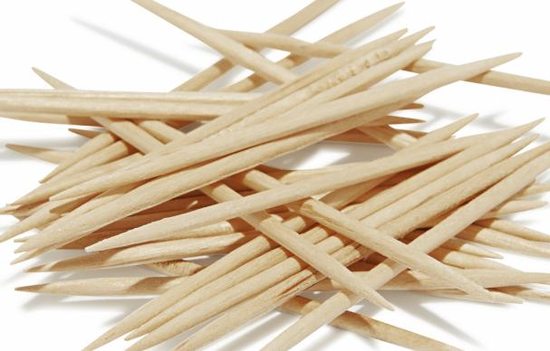
Resilience is…
The ability to bounce back from adversity
The process of managing stress and functioning well even when faced with challenges, adversity and trauma
… the ability to not only survive but thrive!
Notes:
Read from slide: Resilience is the ability to not only survive but thrive.
Demonstrate with toothpick and rubber band:
Tell me how these 2 items relate to resiliency (use chat or unmute)
If we bend this toothpick as far as we can, really putting stress on it, “What will we see?” ‘We will see that eventually this toothpick will break.’
Now if we put stress on this rubber band, you will see the rubber band will stretch but probably not break.
Also, in order for a rubber band to move forward, we need to pull it back first. Just like in life, if something happens that knocks us back for awhile, we may fall back, but then look – we move forward, stronger than ever! (pull back rubber band and let go)
Research on resilience has been exploding over the past several years, with many different models and definitions being developed. Here we will use a relatively simple definition of resilience but acknowledge that resilience is also a process.
Slide key points:
1. Illustrate resilience with toothpick/rubber band either by demonstrating
2. Resilience is the ability to bounce back from adversity and is a process of managing stress well even when faced with challenges.

Slide 23
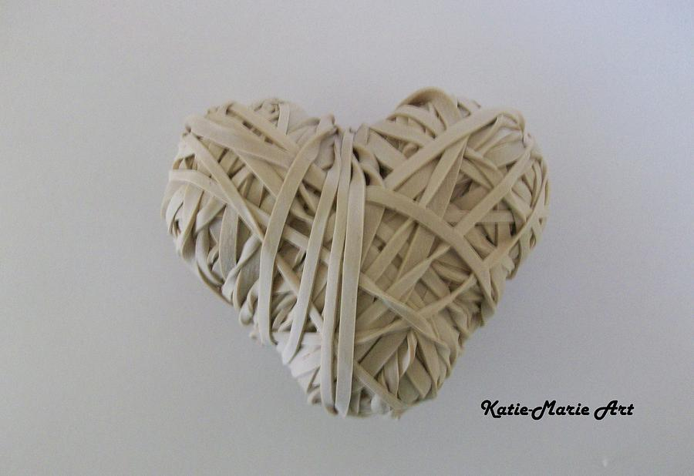
Resilience is…
ordinary, not extraordinary
not a trait that people either have or do not have but a process
behaviors, thoughts, and actions that can be learned and developed in anyone
influenced by a person's environment
Because resilience can be learned, it can be strengthened.
Notes:
Other key findings about resilience to keep in mind are that research has shown that resilience is…
- ordinary, not extraordinary. Everyone has the capacity for resilience.
- not a trait that people either have or do not have, but rather a process.
- Resilience involves behaviors, thoughts and actions that can be learned and developed in anyone. It is part of healthy development and not applicable to adverse circumstances only.
- Resilience is influenced tremendously by a person's environment.
Because resilience can be learned, it can be strengthened.
Slide key points:
Resilience is a process and can be learned and developed in anyone.
Resilience is greatly influenced by a person’s environment which means we can all work to strengthen it for children.

Slide 24
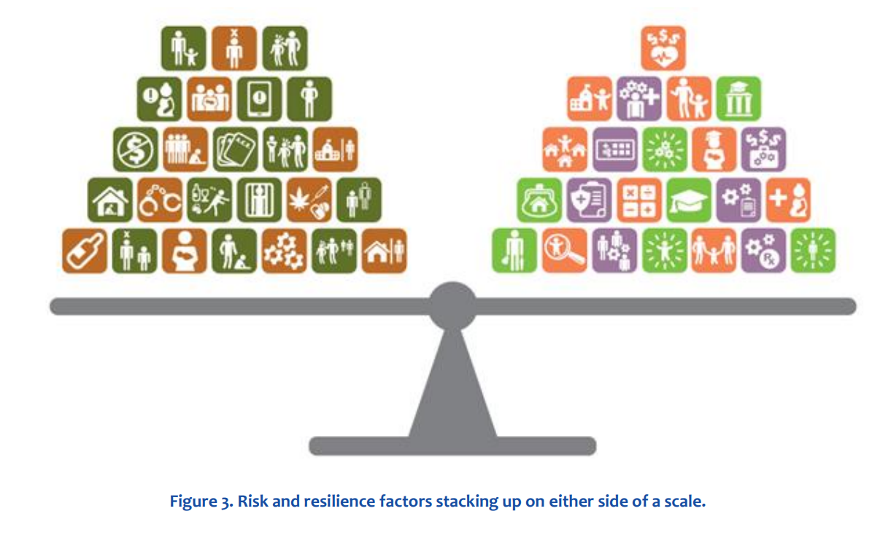
The Resilience Scale
Risk factors and protective factors
Resilience is having a scale that tips positive even when a lot of things are stacked on the other side
Risk factors
Protective factors
Notes:
Here is one way of thinking about resilience that has been used by the Wisconsin Office of Children’s Mental Health emphasizing we all have a mix of risk and protective factors in our lives.
Thinking of a child’s life as a scale, there are things stacked on both sides that shape a child’s development.
The factors stacked on either side of a scale determine how the scale tips. Not all factors weigh the same.
We want children to have scales that tip positive. Resilience is building up the side of the scale to tip positive even when a lot of things are stacked on the negative side.
Children are born with a fulcrum point in a certain place that represents the child’s internal factors, such as genetics and disposition. These factors impact how easy or difficult it is to move the fulcrum one way or the other. The fulcrum’s early position matters a lot, but it can also shift over time.
Ultimately, these indicators illustrate a theory of change predicting that more protective, positive experiences tip the child toward resilience and overall positive outcomes. More simply, the more support children receive, the more hopeful their future.
Slide key points:
One way to think of resilience is as a scale made up of positive factors on one side and negative factors on the other side.
Resilience is achieved when the scale tips positive.

Slide 25
The Youth Development Process: Resiliency In Action
External Protective Factors
Youth Needs
Internal Protective Factors
Caring Relationships
Meaningful Participation
High Expectations
Mastery
Respect
Challenge
Power
Meaning
Belonging
Love
Safety
Cooperation
Empathy
Problem-Solving
Self-Efficacy
Self-Awareness
Goals and Aspirations
Improved Outcomes Health, Social, and Academic
Home
School
Community
Peers
Notes:
HANDOUT - Youth Development: Resiliency in Action model (in the google folder)
Again, there are many definitions and models of resiliency that have been developed by experts in the field. The model presented here is one that works well when thinking about adolescents and emphasizes youth development. One main take away from this model (point to factors on left), is that resiliency is made up of both external protective factors, or what surrounds a child, like caring adults, as well as internal protective factors (point to middle right box), like problem-solving skills. The model also includes youth needs as an important piece that when met, works together with the individual and environmental protective factors to build resilience.
Today we will focus first on the external protective factors that support resilient youth from this model (caring relationships, meaningful participation, and high expectations) and then we’ll talk about some of the other strategies or protective factors that support youth needs listed here, such as mastery and challenge.
Slide key points:
Introduce model emphasizing it works well for adolescents and highlight the key components of both external/environmental and internal/individual protective factors.
Transition to talk about external protective factors – caring relationships, meaningful participation, and high expectations.
Introduce the worksheet.

Slide 26
­­­Strategies to Build Resiliency
Resiliency is the ability to bounce back from adversity and the process of managing stress and functioning well even when faced with challenges, adversity and trauma
For each factor below, there is space to write down examples of what you already do, or new ideas for how you can build resiliency for youth and/or for yourself. For youth, think about a young person you would like to help make stronger and which of these areas might be most important to them. For yourself, think about the relationships or experiences you have had that helped you in the face of challenges in your life, or what could you do differently to build your own resiliency.
Notes:
HANDOUT - Strategies to Build Resiliency (printed from the google folder or email attachment)
This is where we will use the handout you can see on this slide. If you don’t have the handout, please use a blank piece of paper for notes.
Each gray box corresponds to one of the slides that follow. As we talk about each of these, you can follow along with the handout. There is space to write down examples or ideas in each area for how you can build resiliency for both youth and/or for yourself. For youth, think about a young person you would like to help make stronger and which of these areas might be most important to them. For yourself, think about the relationships or experiences you have had that helped you in the face of challenges in your life, or what could you do differently to build your own resiliency. Writing notes on this handout will be helpful in completing the evaluation at the end of this workshop.
Let’s start with external factors that support resiliency. These are all things we can provide in our everyday work or interactions with youth.

Slide 27
Caring Relationships
A caring and supportive relationship remains the most critical variable throughout childhood and adolescence (B. Benard)
Connections Video
Notes:
The first and arguably most important of the protective factors that build resilience is Caring Relationships.
Positive relationships are important for youth resiliency whether it’s having a supportive caregiver at home, a caring adult at school or in the community, as well as positive peer relationships. Caring relationships are supportive connections to others and having a person who is there and who listens non-judgmentally.
Many studies have emphasized having a caring and positive adult role model is a critical component of youth resiliency. For youth, a caring relationship with a trusted adult conveys compassion, understanding, respect and interest, is grounded in listening, and establishing safety and basic trust.
PLAY VIDEO (EXAMPLES AFTER FIRST 3)
Teacher handshake video: https://www.nbcnews.com/video/teacher-s-twist-on-a-high-five-has-students-smiling-867194947871 (1 minute, 7 seconds)
Other Examples: Sending a letter to students before the start of a school year; Chippewa Falls blue dot example -- all kids names are on a wall and teachers put a sticker by kids they know/have a relationship with. When they were done could see kids who needed connection and make a plan for it; Your own example or ask for audience examples.
Slide key points:
“A caring and supportive relationship remains the most critical variable throughout childhood and adolescence.” Having a caring and positive adult role model is a critical component of youth resiliency.
Share examples (video, other examples above, or your own example).

Slide 28
Meaningful Participation
Provide opportunities for problem- solving, decision-making, goal- setting, helping others and sharing power with youth in real ways.
Notes:
The next of the external assets we can help build for youth is Meaningful Participation. Youth need opportunities to participate in activities that are meaningful, relevant, engaging and foster a sense of responsibility and contribution.
Meaningful participation also means engaging young people in decision-making that recognizes their value and their contribution (We underutilize kids…big time)
Meaningful participation is connecting kids to activities that matter to them and ensuring young people set their own goals and how to best achieve them. They are treated as actors in their own lives.
In practice this is providing opportunities for problem-solving, decision-making, goal-setting, helping others, and sharing power with youth in real ways.
EXAMPLES AFTER 1ST 3
Examples: An example of this in practice might be having youth set ground rules or agendas for whatever the task of the group is, or giving kids the opportunity to provide input/feedback following a lesson, program or activity using their voice to make it better; Audience examples
Slide key points:
Youth need opportunities to participate in activities that are meaningful, relevant, engaging and foster a sense of responsibility and contribution.
In practice this is providing opportunities for problem-solving, decision-making, goal-setting, helping others, and sharing power with youth in real ways.
Optional - share your own or audience examples.

Slide 29
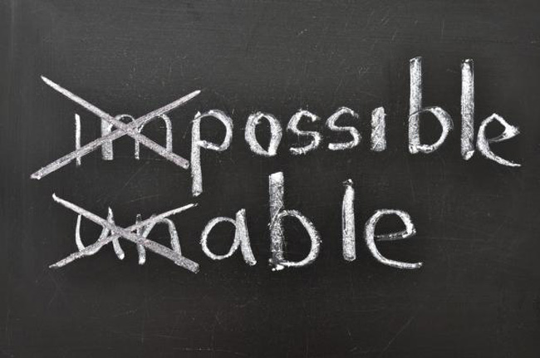
Positive and High Expectations …with support
High expectation messages communicate firm guidance, structure and challenge but also convey a belief in the innate resilience of youth.
Notes:
Messages of High Expectations communicate not only firm guidance, structure, and challenge, but convey a belief in the innate resilience of youth. It looks for strengths and assets as opposed to problems and deficits. The most obvious and powerful is at the belief level, where adults and staff communicate the message that a student has everything they need to be successful. High expectations also include providing structure through setting boundaries and rules -- kids benefit from limits and consequences.
Perhaps more than any other variable, low expectations on the part of youth-serving staff have been correlated with poor outcomes and vice versa: high expectations—with the support necessary to meet them—directly relates to positive outcomes. Have you heard, “This kid isn’t ready to learn…he’s got too many problems”? Kids who are labeled by schools and agencies in this way often adopt low expectations for themselves. A response framed by resiliency is that he only gets one chance to be 12 and in 7th grade, let’s not give it away. Keep the expectations realistic and provide support, and the belief that this child can succeed front and center!
To summarize, the first 3 factors (Caring Relationships, Meaningful Participation, and High Expectations) represent external assets that have consistently been shown to help young people bounce back from stress and adversity.
Optional audience engagement: Ask participants to share examples (unmute or in chat) of an important relationship in their lives, when they have used meaningful participation or high expectations for a young person or in their lives, or any other comments about the first 3 (e.g., who in your life has had high expectations for you) Could also use breakout rooms or whiteboard here.
Slide key points:
High expectation messages communicate not only firm guidance, structure, and challenge, but convey a belief in the innate resilience of youth. It looks for strengths and assets as opposed to problems and deficits.
Kids who are negatively labeled often experience unrealistically low expectations from those around them and adopt low expectations for themselves. Flip this thinking and raise expectations for all kids, with support.
Optional - share examples.

Slide 30
Mastery
Notes:
The next several slides are additional considerations to help kids be resilient. In many cases, these suggestions come from youths themselves.
Mastery
It is important for adolescents to have one or more things they can do well, take pride in, and share with others. This could be hobbies, sports, performing arts, computer technology, or others. Mastering a skill helps kids experience success.
Those who have experienced trauma feel a tremendous sense of loss of power. Mastery is very important.
Mastery is not about talking. It’s about doing. If academic learning is not a strong area, what is? Think about ways we can help kids figure this out. It is critical to help them remember what they are good at and encourage them to do more of that stuff!
Slide key points:
Transition from the 3 external protective factors from the youth development in action model, to examples of addressing other youth needs and protective factor strategies.
Connect kids to something they are good at to build self-confidence and self-efficacy.

Slide 31
When ordinary conversations become extraordinary
Notes:
Real Talk
Real talk is providing opportunities for kids to talk about the issues in their lives that affect them the most. This is something kids are asking for. They want time to be together in small groups in schools where peer support is first, and adults are there to control the drama if it gets off track.
Young people are hungry for meaningful dialogue about race, sexuality, social media, politics, what’s fair and what’s not, gender issues, who they are becoming, what the future holds, the planet…all of it.
For kids who are struggling, this may happen with a counselor -- that’s great. Kids need more opportunity for Real Talk in ALL aspects of their lives. It can just be asking for their thoughts and opinions on a topic or issue.
Also, when a young person opens up, don’t feel like you need to fix problems as they come up (you can refer them to counseling), simply LISTEN.
Both Mastery and Real Talk provide youth with opportunities to connect with peers and adults in positive ways, emphasizing their contributions and strengths.
Slide key points:
Kids look for opportunities to talk about things that matter to them and to be listened to.
Can be structured time in small groups, 1 to 1 or peer counseling, or just everyday connections and conversations. Ask kids to share their opinions and to weigh-in on things they care about.
Optional - share examples.

Slide 32
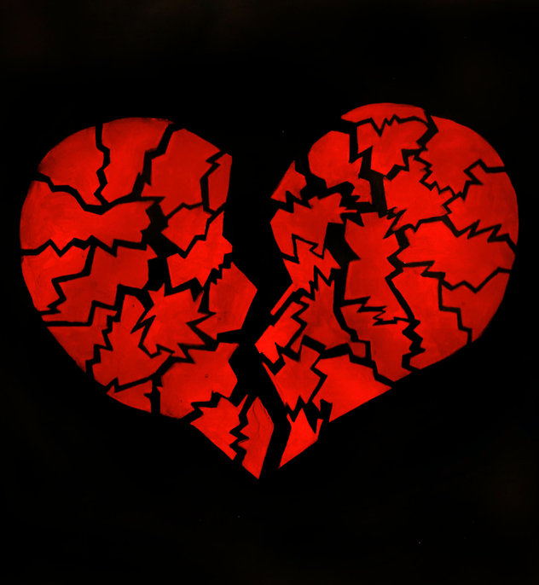
Creative Expression
“If your heart is broken, make art with the pieces”
Shane Koyczan, Poet
Notes:
Creative Expression
This can be an undervalued form of hope and healing. Most kids can describe being moved by art or music. They can “get their feelings out” through expressing themselves and how they see the world in metaphors, photographs, poetry, journaling, and creative arts in all forms.
When we bury feelings that are painful, we become powerless to our story. It is difficult to embrace our own vulnerability and let others get close to us. Creative expression is a way to release those feelings in a healthy and healing way.
For some youth creative expression overlaps with mastery and meaningful participation and can be a way for youth to connect to their community and important relationships based on shared skills.
Audience engagement: As an example of creative expression, use whiteboard and ask participants to create a symbol, draw, or write one thing they are grateful for today.
Slide key points:
Creative expression can help with healing through the process of creating art. music or writing.
It is a way to create connections with others.
Optional – share examples.

Slide 33
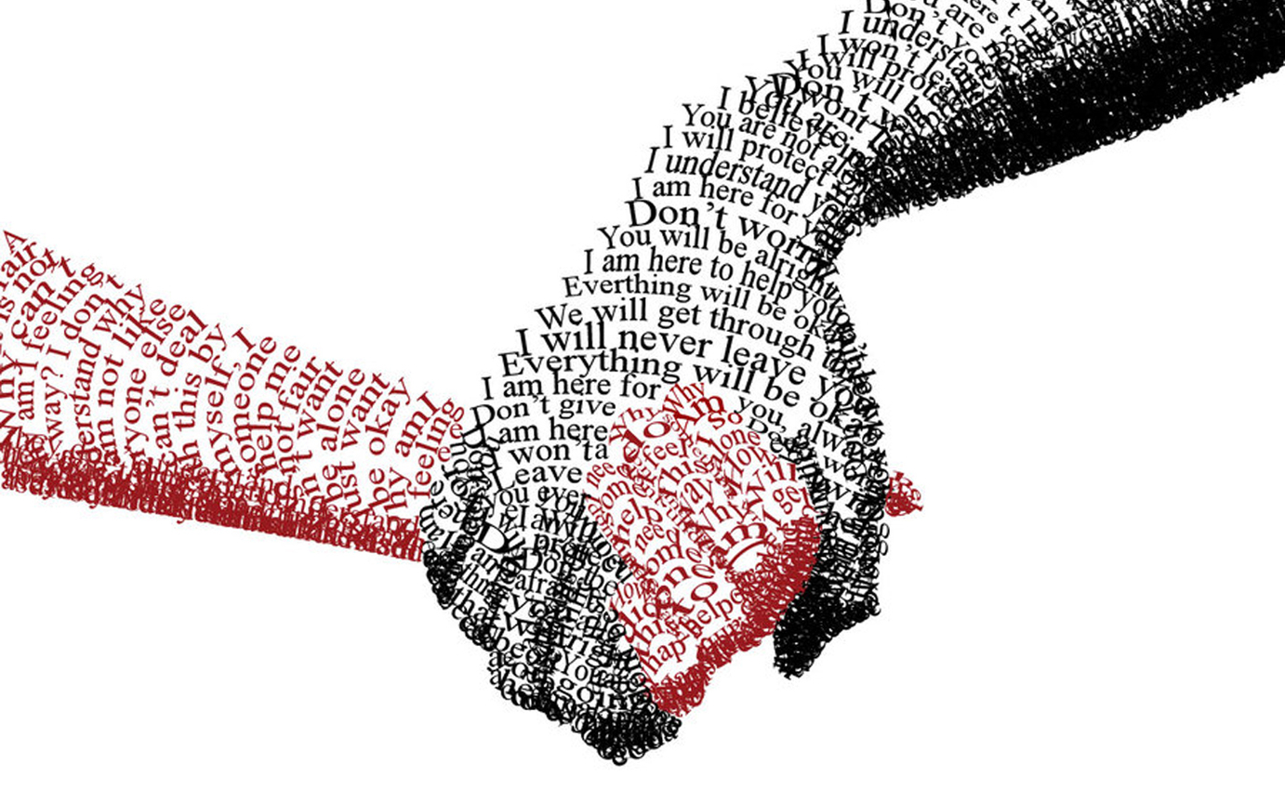
Service to Others
“We rise by lifting others.”
-Robert Ingersoll
Notes:
Service to Others
It is important to capitalize on young people’s altruism, desire to be useful, and optimism about the world.
Youth benefit from and are ready to step up and help other people. It feels good to help others.
For youth who struggle, helping others through simple activities like reading to younger kids or helping another young person who’s in trouble or is going through something similar can be especially meaningful.
Optional: Because of all that’s happened over the last year, people have helped one another cope and get through difficult times. What have you seen people do for others, how have you helped, how have others helped you, or what have you seen young people doing?
Slide key points:
Helping others has a positive impact on kids.
Optional – share examples.

Slide 34
Cultural Identity
To Be Seen. Understood. Empowered.
Notes:
Cultural Identity
Last, let’s talk about Cultural Identify. Cultural identity is how a young person identifies with their culture, and how that culture, in turn, impacts them. It includes race, nationality, gender, age, sexuality, history and religious beliefs and is manifested in traditions and beliefs that teach how to interact with their world.
When cultural identify is not addressed, kids are at increased risk for unhealthy behaviors and outcomes.
At its core is a sense of belonging -- when there is an intolerance of their cultural identity or they feel excluded, a young person’s resilience is compromised.
We see this in the surveys our kids take, like the Youth Risk Behavior Survey. Kids from diverse backgrounds and with various sexual orientations want support for their cultural identity. When they don’t get it, the price is very high.
Place to include stories or sharing related to current anti-racism movement.
As a sidenote, if you are interested in reviewing kids' responses to mental health-related questions from the 2019 YRBS, two Youth Mental Health Scorecards (1 for Chippewa and 1 for Eau Claire) have been developed by Mental Health Matters and are available in the “Optional Handouts” folder in Google Docs.
Slide key points:
Cultural identity is how a young person identifies with their culture, and how that culture, in turn, impacts them.
When there is intolerance of cultural identity or they feel excluded, a young person’s resilience is compromised.
Provide support for cultural identity.
Optional - share examples and refer to Youth Mental Health Scorecards

Slide 35
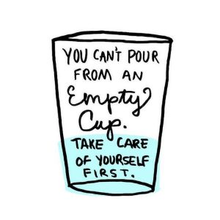
Resilience in Us
How can we use a resiliency framework for youth if we are stressed and burned out ourselves?
Notes:
Resilience in Us
How can we use a resiliency framework for youth if we are stressed and burned out ourselves? It’s a lot more difficult! Before we can help youth, it is important to “flip the mirror” and focus on ourselves. What do we do and what support do we need to focus on our own wellness and resilience?
We don’t always see burnout in ourselves but may see it in our colleagues. Audience question: What does stress look like in our jobs as we’re serving others? (ask for answers in chat) Example answers: We might be more judgmental, inflexible, rush to decisions, less likely to include input from those we serve, see more client resistance, tired, yet hard to sleep, trouble concentrating, avoidance, collapse when we get home and our stress can impact others. Think about how to reach out when you see this in someone else and how you could do the same for yourself.
Tapping into our own resilience means identifying the protective factors in our own lives. You may have already written down some ideas on your worksheet about how you already do this or could do this for yourself. For example… Reconnect with your sense of purpose and why you chose your profession. Where is the meaning in your work? Keep learning; Mentor others; Solve the problems you can and accept and let go of what you can’t; Mastery – remember what you are good at!; Have meaningful conversations with those you trust (staff self-care circles, debriefing), colleagues and friends who support the work; We are in this together…you understand, you have my back, you help me grow…; Taking time for self-care – mindfulness, nutrition, physical activity, sleep, laughter etc.
Audience engagement: What have you been doing to take care of yourself, especially during the COVID-19 pandemic? Chat, unmute for examples.
Slide key points:
Before we can help youth, it is important to “flip the mirror” and focus on ourselves. How are we taking care of ourselves?
Share or ask for audience examples: What do you do for yourself to build resilience?

Slide 36
The Resiliency Attitude
“I see what is right with you, no matter what you have done in the past, no matter what problems you currently face.
Your strengths are more powerful than your ‘risks.’
Whatever risks, problems, and adversity you are facing there are steps on the road to bouncing back – they are not the end of the road.”
Nan Henderson, Fostering Resiliency in Children and Youth
Notes:
The Resiliency Attitude
The bottom line is that resiliency focuses on how can we promote the strengths of youth and amplify what is already good.
Nan Henderson is the author of Fostering Resiliency in Children and Youth. She calls this the “Resiliency Attitude.”
Optional read from slide -- “I see what is right with you, no matter what you have done in the past, no matter what problems you currently face. Your strengths are more powerful than your ‘risks.’ And whatever risks, problems, and adversity you are facing there are steps on the road to bouncing back – they are not the end of the road.”
Therefore, using a strengths approach is to:
Focus on what works well
Recognize strengths are the building blocks of resilience
Explore and identify protective factors and individual strengths to help individuals become more aware of their own abilities, talents and skills
Slide key points:
Resiliency focuses on how can we promote the strengths of youth and amplify what is already good.
Exploring and identifying their strengths helps individuals become more aware of their own abilities and builds resilience.

Slide 37
Making an Impact
How have you promoted resilience for the youth you work with?
What is one action you plan to take or one change you will make in your work with youth moving forward?
What is one follow-up action you would like to see your organization take?
1
2
3
Notes:
Making an Impact
Let’s consider the 1st box on this slide and think about how you’ve promoted resilience for youth you work with. On your worksheet, take a few minutes to write down any other ideas for any of the factors discussed.
Now let’s use breakout rooms to discuss for 10 minutes the second two questions on this slide. The questions will be included in the chat for reference.
In the CHAT: What is one action you plan to make in your work moving forward to support youth resilience? What is a follow-up action you would like to see your organization take?
You will see an invitation to enter a breakout room. Please discuss the questions for 10 minutes and then we will come back as a large group to share 1-2 examples per breakout room. Be thinking of who will report-out to the larger group.
Presenters: use the same breakout rooms as previous. Come back after 10 minutes and ask one person from each group to unmute and share a highlight from discussion. Before sharing begins, indicate these examples can be used in the evaluation following this workshop.
Slide key points:
Review the questions: How have you promoted resilience for the youth you work with? What is one action you plan to make in your work moving forward to support youth resilience? What is a follow-up action you would like to see your organization take?
Share 1-2 ideas/group with the large group for the last 2 questions.
Ask participants to include their ideas for action (individual and organizational) on the follow-up evaluation form.

Slide 38
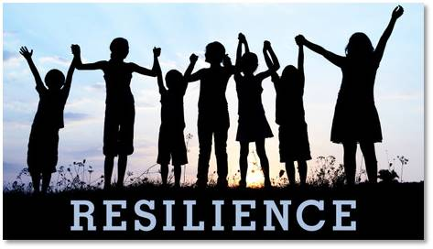
Remember
We can create and strengthen a network of buffers and support for kids and families
In our own work with kids
In systems and organizations
In the community
Every system or organization that touches an aspect of a child’s life can contribute to resilience.
Notes:
Most of what we covered today focused on what you can do to support resilience individually as you work with or interact with youth. It is important to remember there are strategies that promote resilience at the level of systems, organizations, and communities.
Some examples of how systems or organizations have addressed ACEs and resilience and include implementing department-wide crisis intervention training for police officers or using trauma-informed care in health systems or human services. Trauma-informed care is a framework in which our questions change from “What’s wrong with you?” to “What happened to you?”
Examples in communities that support resilience are promoting policies that support families, like making quality childcare affordable and accessible for all or creating a trauma-informed community culture.
Slide key points:
Resilience can be addressed at the level of systems, organizations, and communities.
Encourage audience to think about how resilience factors could be addressed at these levels, especially for their own organizations.

Slide 39
Acknowledgements
Created by the Mental Health Matters work team:
Brook Berg, Barb Habben, Michelle Johnson, Deb Pattee, Peggy O’Halloran, Nicole Clements, Brenda Scheurer, Angela Weideman
Special thanks to expert contributors:
Angela Weideman (Chippewa Co. Health Dept) and Monica Caldwell (DPI)
Special thanks to our reviewers:
David Huber, Lisa Quinn-Lee, Kent Smith, Monica Caldwell
Notes:
Thank you for your time today. We hope the information today was useful and helps you move forward with building resiliency for youth. We’d like to acknowledge the following who helped develop, contribute to and review this workshop.

Slide 40
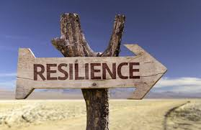
Thank You!
Notes:
Share presenters' names again.
Because this is a grant-funded workshop, it is really important we receive your feedback for reporting purposes. Please take a few minutes to complete the evaluation – a link is provided in the chat.
In the Chat:
https://www.surveymonkey.com/r/NKB5GKP
The slides for this workshop as well as other resources and handouts are in the google drive. Feel free to refer to them at any time.
Slide key points:
Share presenter contact information.
Encourage completion of online evaluation form.
Share any final resources, handouts, etc. Refer again to google file.

Slide 41
References & Resources
Centers for Disease Control and Prevention: ACE study
https://www.cdc.gov/violenceprevention/acestudy/index.html
Robert Wood Johnson Foundation: ACEs
https://www.rwjf.org/en/library/infographics/the-truth-about-aces.html
Wisconsin Child Abuse and Prevention Board: ACEs
https://preventionboard.wi.gov/Pages/OurWork/ACE.aspx
https://preventionboard.wi.gov/Documents/ACE-Brief_2018FINAL.pdf
The Building Community Resilience Collaborative: Pair of ACEs
https://publichealth.gwu.edu/departments/redstone-center/resilient-communities
Wisconsin Department of Public Instruction School Mental Health
https://dpi.wi.gov/sspw/mental-health

Slide 42
References & Resources
Harvard University’s Center on the Developing Child: Science of early childhood
https://developingchild.harvard.edu/science/
https://developingchild.harvard.edu/science/key-concepts/
American Academy of Pediatrics: Early Brain and Child Development Education and Training Modules
https://www.aap.org/en-us/advocacy-and-policy/aap-health-initiatives/EBCD/Pages/educationModules.aspx
American Psychological Association: The Road to Resilience
http://www.apa.org/helpcenter/road-resilience.aspx
The Frameworks Institute: The Resilience Scale
http://www.frameworksinstitute.org/assets/files/ECD/resilience_em_report_final.pdf
Bonnie Benard: Foundations of Resiliency Framework
https://www.resiliency.com/free-articles-resources/the-foundations-of-the-resiliency-framework/

Slide 43
References & Resources
WestEd & the California Healthy Kids Survey: Resilience and Youth Development Model background resources
http://chks.wested.org/using-results/resilience-youth-development/
http://surveydata.wested.org/resources/ListeningToStudents.pdf
Nan Henderson: Fostering Resiliency in Children and Youth
https://www.resiliency.com/free-articles-resources/hard-wired-to-bounce-back/
https://ccsme.org/wp-content/uploads/2017/01/Fostering-Resiliency.pdf
Wisconsin Office of Children’s Mental Health
https://children.wi.gov/Pages/Home.aspx
https://children.wi.gov/Pages/Integrate/ResilienceWorkgroup.aspx

Slide 44
Workshop Videos
Slide 7: ACEs Video (4 minutes, 59 seconds)
Slide 15: Baby & Parent Video (2 minutes, 50 seconds)
Slide 16: Pruning Video (1 minute, 57 seconds)
Slide 18: Neuroplasticity Video (2 minutes, 3 seconds)
Slide 26: Connections Video (1 minute, 7 seconds)

